Slide 1
English
Week 4 lesson 1

Slide 2
Grammar – Relative clauses
A relative clause is a type of subordinate clause. It does the same job as an adjective, giving more information about a noun or pronoun.
Relative clauses start with a relative pronoun. The relative pronoun used depends on the person or type of thing you are writing about. Relative pronouns include:
‘Who’ - A person or people.
‘Which’ - An object, a place or animals.
‘That’ - An object, a place or a person.
'When’ - A time.
‘Where’ - A place.

Slide 3
The relative clause can go at the end of a sentence or in the middle. It will always start with a relative pronoun.
The boy, who lives next door, was walking down the street.
I won’t stand by the man who smells of slime.

Slide 4
TASK: Use the relative pronouns to create your own sentences. who, which, that, whose, whose, when
Use these examples to help.
Paula, who is my big sister, gave me her pen to use at school.
Paris, where we first met, is a beautiful city to visit.
On Saturday, when it is dark, we will the Christmas lights being turned on.

Slide 5
LO- to be able to research a topic.
SUCCESS CRITERIA:
1) I can read information carefully.
2) I can select important facts and record them.
3) I can watch a video clip and record key facts.
4) I can read back over my notes and make sure that they make sense.
EXTENSION:
5) I can add extra info of my own to my notes.
CHALLENGE: I can ensure that my writing is legible so that I read my notes.

Slide 6
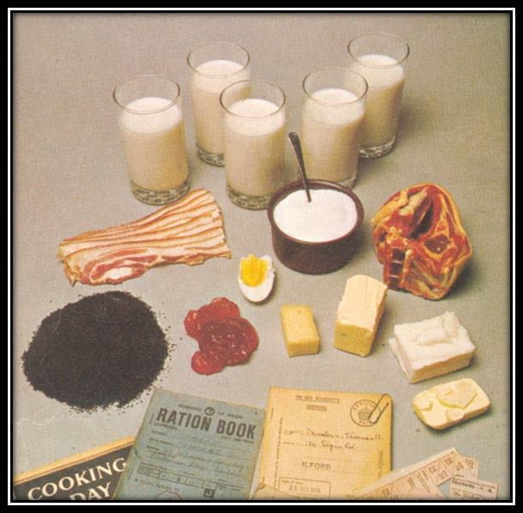
Recap
Why was rationing enforced in the Second World War?
What did this mean for families?
What happened as a result of rationing?

Slide 7
Vocabulary
Recap Vocabulary:
Shortage
Import
Rationing
allotment
New Vocabulary:
Fortifications
Liberate

Slide 8
Vocabulary
Recap Vocabulary: Shortage - a state or situation in which something needed cannot be obtained in sufficient amounts.
Import - bring (goods or services) into a country from abroad for sale.
Ration - allow each person to have only a fixed amount of (a particular commodity).
Allotment - a plot of land rented by an individual for growing vegetables or flowers.
New Vocabulary:
Fortifications - a defensive wall or other reinforcement built to strengthen a place against attack.
Liberate - free (a country, city, or people) from enemy occupation.

Slide 9
Everybody Reads!
Quiz!
What is the Battle of Normandy more commonly known as?
What were the Allies trying to achieve?
Why was D-day classed as a turning point in WW2?
Who were the Axis powers?
D-Day is a military term designating the start of a military operation.
The D-day in modern history refers to what happened on 6th June 1944 - the day on which the Battle of Normandy began.
It was a huge effort involving months of secret preparations. Thousands of Allied troops landed on the beaches of Normandy, in northern France, at the start of the battle to liberate mainland Europe from Nazi occupation.
D-day marked the turning point in World War II when the Allied forces began to win their fight against the Axis powers.
The invasion was code-named Overlord.

Slide 10
Read through the following slides and record key facts in your books
Interesting facts about D-Day…

Slide 11
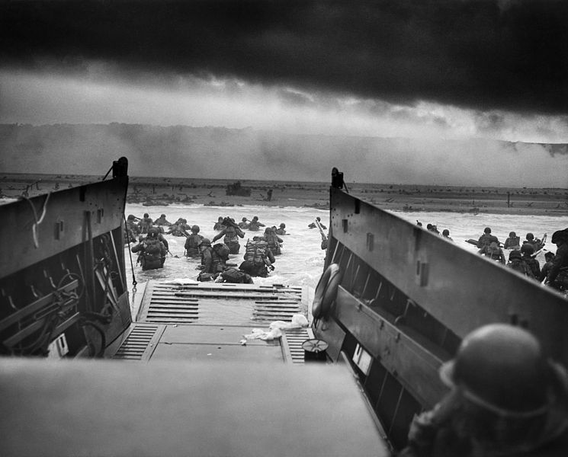
D-Day
The term D-Day refers to a specific date for a planned operation, often a military attack.
However, the term D-Day has also become synonymous with the allied attack on the beaches of Normandy which took place on 6th June 1944.
Photo courtesy of Chief Photographer's Mate (CPHoM) Robert F. Sargent (@wikicommons) - granted under creative commons licence

Slide 12
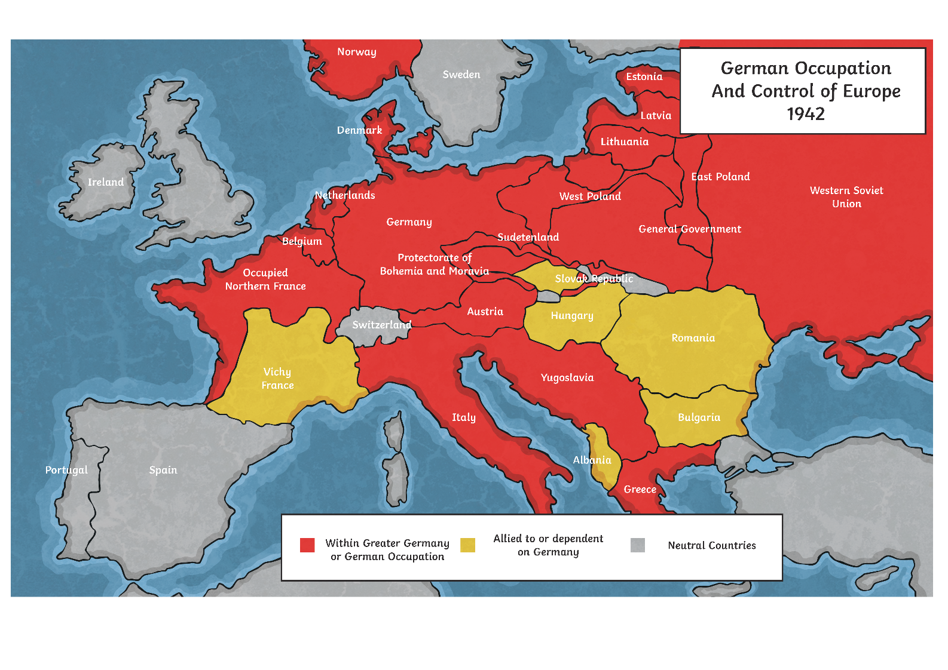
The Atlantic Wall
During the Second World War, Germany was in control of much of Europe.
This map shows which countries were controlled by Nazi Germany in 1942.

Slide 13
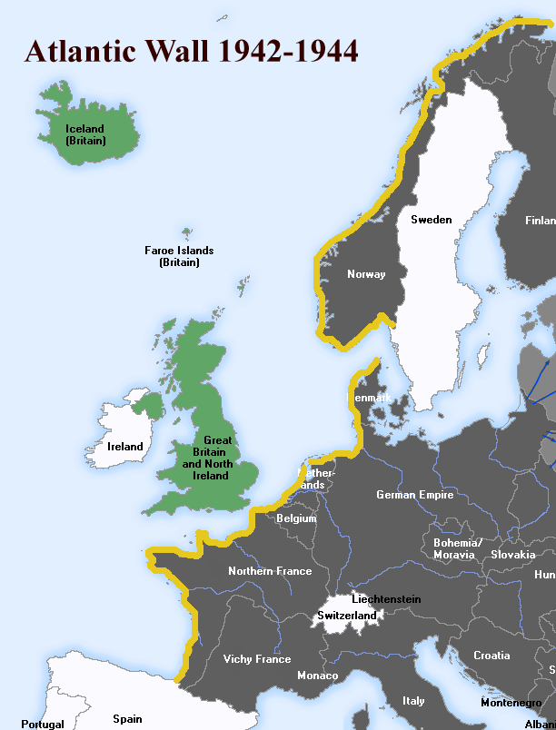
The Atlantic Wall
Strongholds secured by Germany in France were fiercely defended and Adolf Hitler ordered the construction of fortifications - known as the Atlantic Wall - along the coastal regions of north-western Europe and Scandinavia in preparation for an expected Allied attack by Great Britain.
Note: Britain occupied the Faroe Islands and Iceland during the war.
Photo courtesy of User:Uberstroker (@wikicommons) - granted under creative commons licence

Slide 14
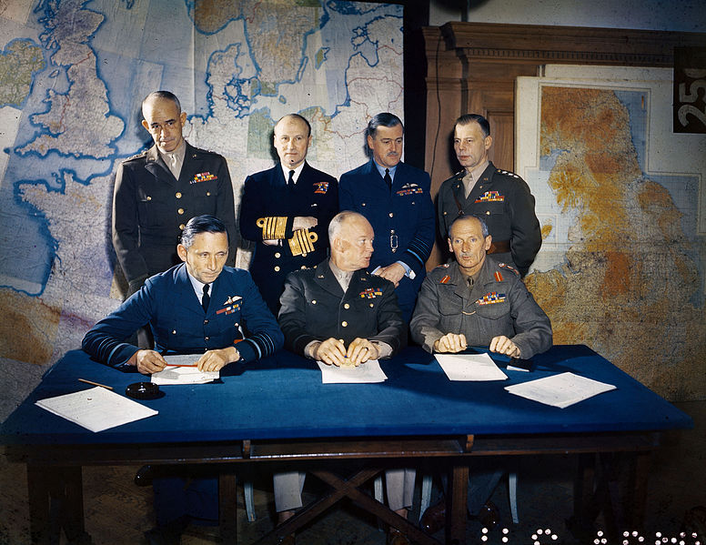
Operation Overlord
From early on in the war, it was clear that in order to secure Allied success, the liberation of north-west Europe from German control was vital. The Allies made plans to try and drive the Germans out of France.
They planned Operation Overlord - a huge military assault which would combine naval, land and airborne attacks on the Germans in France.

Slide 15
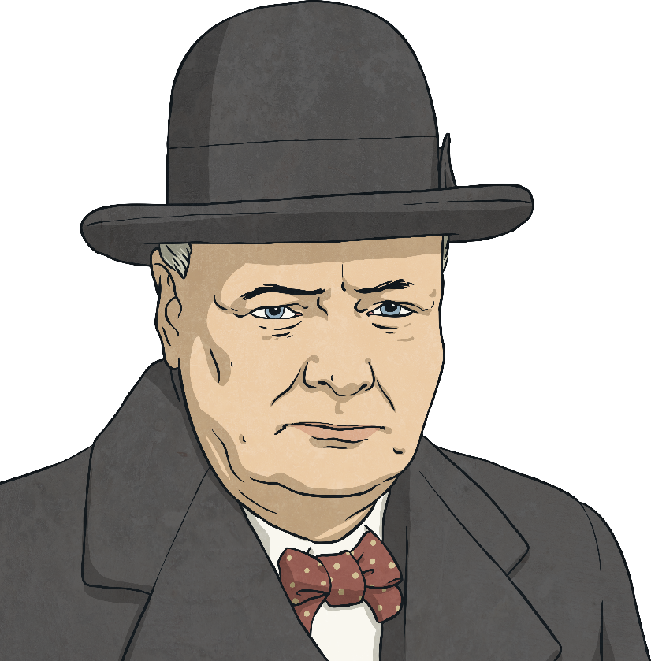
Operation Overlord
Every detail of the operation was so intricately planned that it took over two years to put the plan into action. Operation Overlord was the biggest military operation the world had ever seen and was a collaborative effort between more than 12 countries.
And what a plan! “This vast operation is undoubtedly the most complicated and difficult that has ever occurred.”
- Winston Churchill

Slide 16
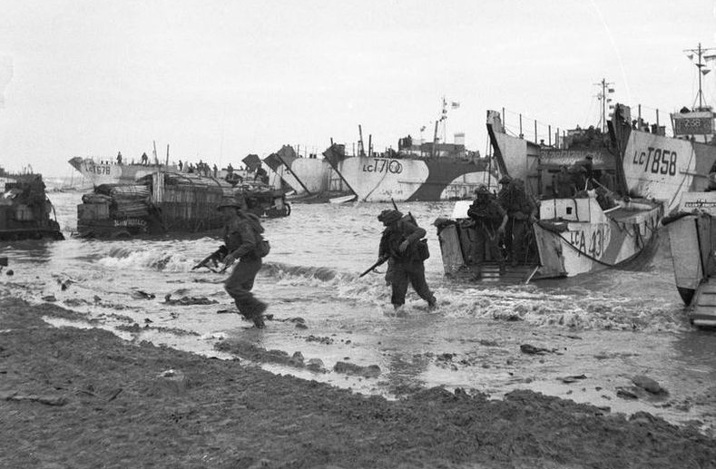
Operation Neptune
The Normandy Landings, which were code-named Operation Neptune, were the first stage of Operation Overlord.
At just after midnight on 6th June 1944, the operation began.
Five key beaches were targeted. Securing control of these areas would give the Allies the best possible chance of fully penetrating into France and completing their ultimate objective.
Soldiers arriving on Sword beach

Slide 17
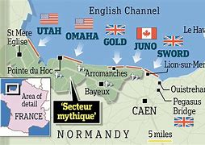
The Beaches
The stretches of beach were given different code names and troops from Britain, America and Canada led the attacks.
Utah – attack led by American troops;
Omaha – attack led by American troops;
Gold – attack led by British troops;
Juno – attack led by Canadian troops;
Sword – attack led by British troops.

Slide 18
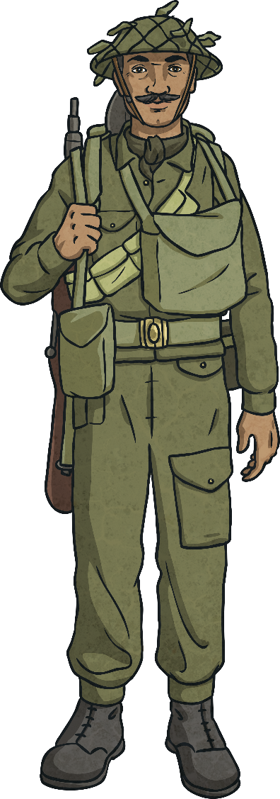
Executing the Plan
Just after midnight on 6th June, Allied paratroopers are dropped behind enemy lines to undermine German defences.
From 6:30am, Allied troops land on the beaches. The shallow waters allow them to wade ashore quietly and take the enemy by surprise.
Throughout the day, Allied air forces overpower the German Luftwaffe and gain control of the airspace.
Allied warships also fire bombs to weaken the German defences along the Atlantic Wall.

Slide 19
Watch the video clip, take notes

Slide 20
D-Day clip for children

Slide 21
Update your notes.
Make sure you can read them.

