Slide 1
Lesson 1:
Computing Scheme of Work Unit 5.2 – Online Safety
Responsibilities and Support when Online

Slide 2
Aims
Slide 2
To gain a greater understanding of the impact that sharing digital content can have.
To review sources of support when using technology.
To review children’s responsibility to one another in their online behaviour.
Need more support? Contact us:
Tel: +44(0)208 203 1781 | Email: support@2simple.com | Twitter: @2simplesoftware

Slide 3
Success Criteria
Slide 3
I can think critically about the information that I share online, both about myself, and others.
I can know who to tell if I am upset by something that happens online.
I can use the SMART rules as a source of guidance when online.
Need more support? Contact us:
Tel: +44(0)208 203 1781 | Email: support@2simple.com | Twitter: @2simplesoftware

Slide 4
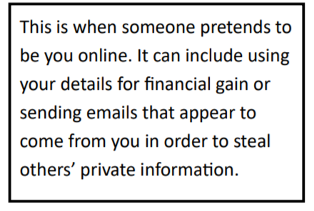
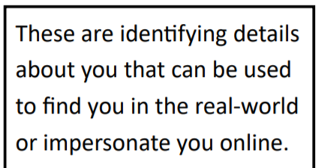
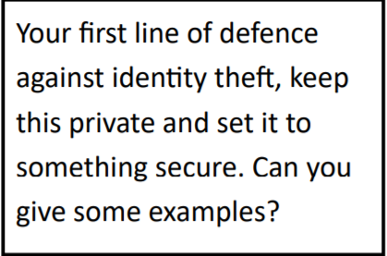
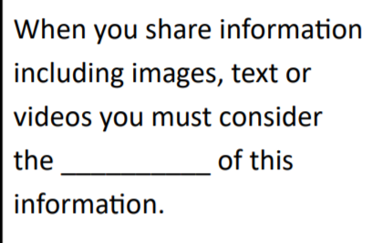
Activity 1: Vocabulary
Slide 4
Match the definitions to each word:
Password Identity Theft personal information Ownership ownership
It can be very confusing!
Need more support? Contact us:
Tel: +44(0)208 203 1781 | Email: support@2simple.com | Twitter: @2simplesoftware

Slide 5
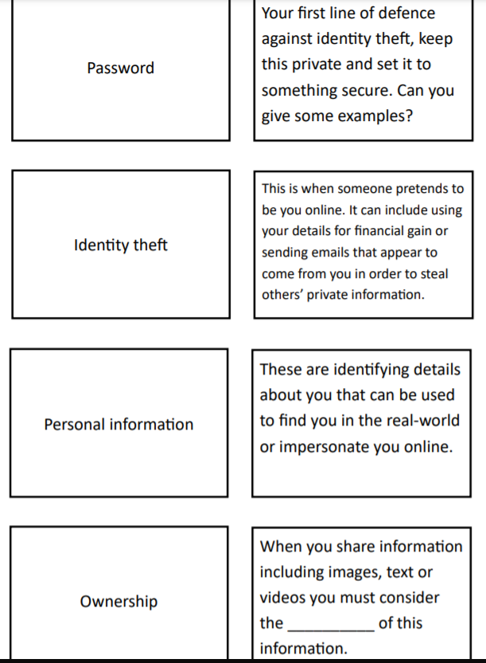
ANSWERS

Slide 6
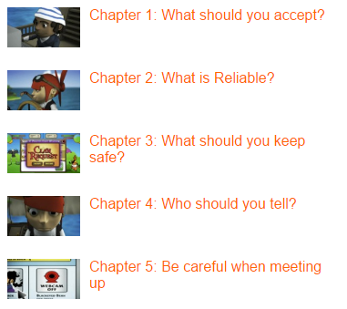
Activity 2: SMART Crew
Slide 5
Watch these video clips from The Childnet website
https://www.childnet.com/resources/the-adventures-of-kara-winston-and-the-smart-crew
While watching the SMART CREW videos from the Childnet website, take down notes to each section.
Each short video clip will contain key online safety information.
Write down the key messages? How do these messages relate to what you do online?
Need more support? Contact us:
Tel: +44(0)208 203 1781 | Email: support@2simple.com | Twitter: @2simplesoftware

Slide 7
SMART Rules
Slide 6
What are the SMART rules?
Need more support? Contact us:
Tel: +44(0)208 203 1781 | Email: support@2simple.com | Twitter: @2simplesoftware

Slide 8
Activity 3: Comic Book
Slide 7
You are going to create your own short comic strip to tell the story of one of the letters of the SMART crew and/or give advice on one of the following topics:
The impact that sharing digital content can have on a person→ cyberbullying.
What to do when things go badly online? (T – Tell example)
How to behave as a responsible digital citizen: Responsibility to each other as well as yourself. (S-Safe)
Being a critical thinker online (R – Reliable), also malware, spam, plagiarism comes into this.
You can use the ideas from the video and apply these to their own character.
S – Safe
M – Meet
A – Accepting
R – Reliable
T – Tell
Plan:
What is the online safety message going to be?
What characters will you create?
How many pages will there be in the comic? Be realistic and think about the time available to write the comic strip.
Think about the ages of the children reading it (9-11).
Need more support? Contact us:
Tel: +44(0)208 203 1781 | Email: support@2simple.com | Twitter: @2simplesoftware

Slide 9
Review Success Criteria
Slide 9
I think critically about the information that I share online, both about myself, and others.
I know who to tell if I am upset by something that happens online.
I can use the SMART rules as a source of guidance when online.
Need more support? Contact us:
Tel: +44(0)208 203 1781 | Email: support@2simple.com | Twitter: @2simplesoftware

