Slide 1
Lesson 2:
Computing Scheme of Work Unit 5.2 – Online Safety
Protecting Privacy

Slide 2
Aims
Slide 2
To know how to maintain secure passwords.
To understand the advantages, disadvantages, permissions, and purposes of altering an image digitally and the reasons for this.
To be aware of appropriate and inappropriate text, photographs and videos and the impact of sharing these online.
Need more support? Contact us:
Tel: +44(0)208 203 1781 | Email: support@2simple.com | Twitter: @2simplesoftware

Slide 3
Success Criteria
Slide 3
I can think critically about what I share online, even when asked by a usually reliable person to share something.
I have clear ideas about good passwords.
I can see how I can use images and digital technology to create effects not possible without technology.
I have experienced how image manipulation could be used to upset myself or others even using simple, freely available tools and little specialist knowledge.
Need more support? Contact us:
Tel: +44(0)208 203 1781 | Email: support@2simple.com | Twitter: @2simplesoftware
Notes:
Display slide 3 and outline the success criteria.

Slide 4
Activity 1: Review
Slide 4
It can be very confusing!
Remind yourself of the smartcrew rules and look back at your comic strip that you did yesterday..
Need more support? Contact us:
Tel: +44(0)208 203 1781 | Email: support@2simple.com | Twitter: @2simplesoftware

Slide 5
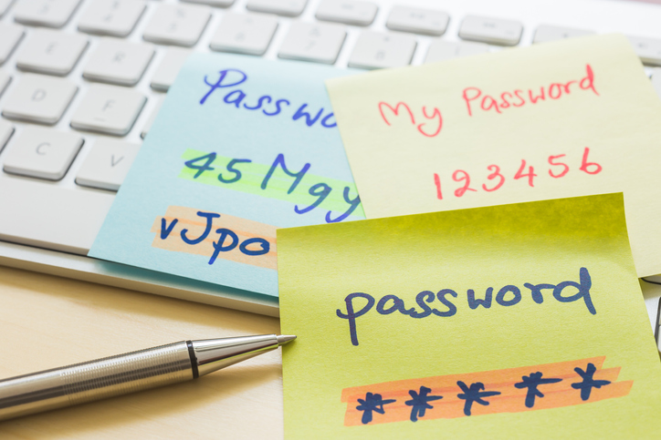
Passwords
Slide 5
Most companies now do not have access to passwords, if a user forgets their password, they are sent a link by email to reset it themselves and the password is encrypted when stored on the company databases. What does encrypt mean?
Encryption
The translation of data into a secret code. Encryption is the most effective way to achieve data security. To read an encrypted file, you must have access to a secret key or password that enables you to decrypt it. Unencrypted data is called plain text; encrypted data is referred to as cipher text.
From https://www.webopedia.com
Your password is the first line of defence against identity theft.
You do need to think critically about what you are asked to do online, even if the request comes from a reputable source.
You might often find yourself in the position of educating your parents or other adults about this as you might have greater awareness of the issues.

Slide 6
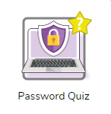
Activity 2: Passwords
Slide 6
What would be your tips for a good, secure password?
Number of characters?
At least 6.
Use of cases?
Use upper and lower case.
Combine types of characters?
Use a combination of letters and numbers and (where allowed by the system) use special symbols such as $ or &.
Now log on to purplemash and open the Password Quiz and complete it.

Slide 7
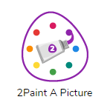
Activity 3: Editing Images
Slide 7
Now you are going to do some image editing.
You will be using the 2Paint a Picture tools and specifically, the eCollage template. You can find this is the Art and Design area of the Tools.
To open this, launch 2PaintaPicture and select eCollage from the front screen. eCollage allows you to use images as stamps, to add clipart and recolour images.
Firstly, you will need to upload an image of yourself. Click on the at the top.
Click on the

Slide 8
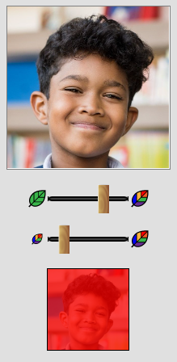
Activity 3: Editing Images
Slide 8
Get an image of your favourite celebrity and pretend it is you.
The stamp image is the bottom square picture box.
Alter the colour filter on the stamp by selecting a colour on the left and altering the top slider to change the level of saturation.
Alter the stamp size by sliding the bottom slider.
You can draw on the image by selecting a colour and using the pen size slider to alter the line width.
Remove parts of the image using the eraser tool (take care with the width).
Clicking on the main screen will place the stamp.
Clicking on the screen, holding down the mouse button or finger and moving the mouse/finger, will rotate the image.

Slide 9
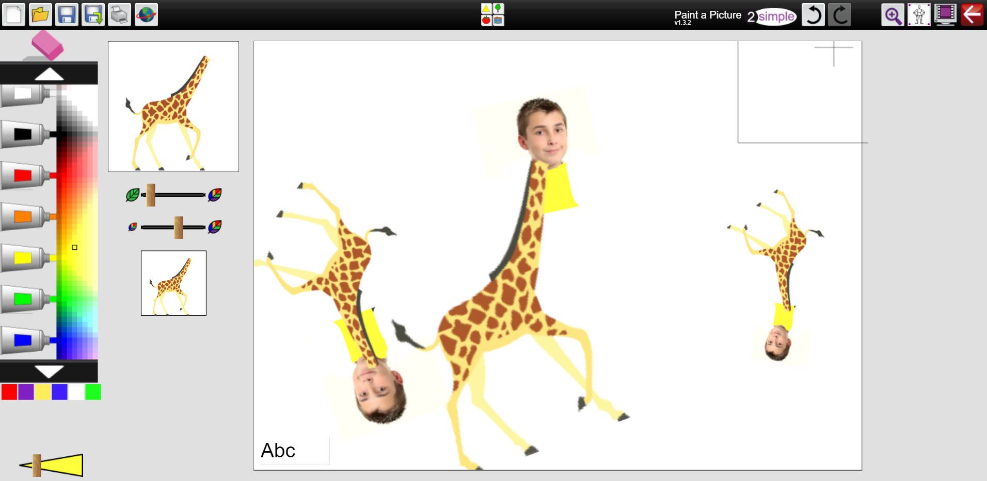
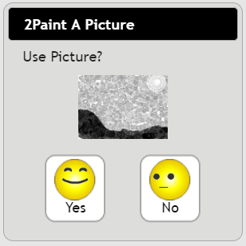
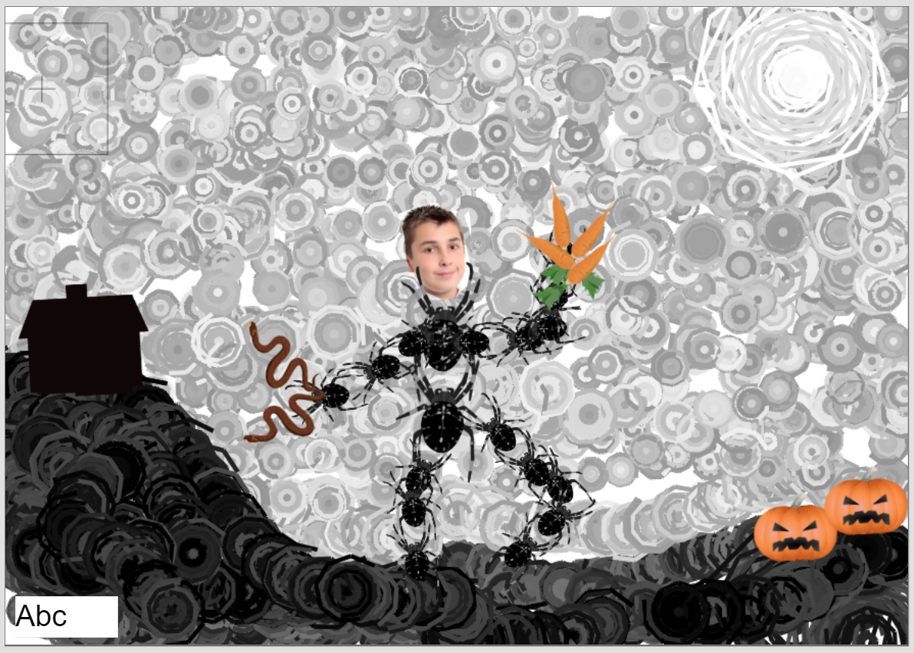
Activity 3: Editing Images
Slide 8
A stamp can be combined with other stamps by selecting additional stamps.
The ecollage effect can be combined with other templates. For example, create a background using a different 2Paint a Pic template, save this. Then click the ‘New file’ button.
Then choose the eCollage template. You will then be offered the option to use the first picture:
This can then be stamped upon:
You should aim to create and save two images: One that you would be happy to share, and one that you would not.

Slide 10
Activity 4: Image Manipulation
Slide 10
Answer the image manipulation questions below
Image Manipulation
How it would feel showing your images to a good friend, someone in the class who knows that they have been doing them in this lesson?
How would you feel if your sibling or family member saw the embarrassing picture?
How would you feel if someone else from the class was able to get a copy of their good picture (online or printed) and then took it home and claimed they had made it or took it to the headteacher and got praise for a creative piece of work?
How would you feel if some children in the other class saw the embarrassing one?
What about if they were children that you did not get on well with?
How would you feel if they printed off lots of copies and stuck them all over the school and added their own ‘edits’ to make the picture even more embarrassing?

Slide 11
Image manipulation questions continued…
How would this change if they then shared the image with the children at a club that you go to?
What about sharing it online so that when anyone searches the internet and puts in your name, this image comes up?
How does it feel to think that this embarrassing image could still come up 10 years from now when someone who is interested in employing you, looks up your name on the Internet?

Slide 12
Activity 5: Extension
Slide 11
Write about the following aspects of image manipulation:
Although it is fun using the erase and stamper tools to modify a selfie, how happy are you to have a photograph of yourself used on a digital system?
What is a better option than using a photograph?
Have you used Avatars on any online platforms?
Why might creating an Avatar be a safer option than using a photograph (modified or not)?
Why do you think that the Avatar maker in Purple Mash does not have an option to take a selfie and use that?
Can you think of any situations when an accurate photograph needs to be used online?
It can be very confusing!
Need more support? Contact us:
Tel: +44(0)208 203 1781 | Email: support@2simple.com | Twitter: @2simplesoftware

Slide 13
Review Success Criteria
Slide 13
I think critically about what I share online, even when asked by a usually reliable person to share something.
I have clear ideas about good passwords.
I can see how a person could use images and digital technology to create effects not possible without technology.
I have experienced how image manipulation could be used to upset people, even using simple, freely available tools and little specialist knowledge.
Need more support? Contact us:
Tel: +44(0)208 203 1781 | Email: support@2simple.com | Twitter: @2simplesoftware

