Slide 1
Lesson 1:
Computing Scheme of Work Unit 5.4 – Databases
Searching a Database

Slide 2
LO: To be able to search for information on a database.
Slide 2
SUCCESS CRITERIA
Children understand the different ways to search a database.
Children can search a database to answer questions correctly.
Notes:
Display slide 2 and outline the lesson aims.

Slide 3
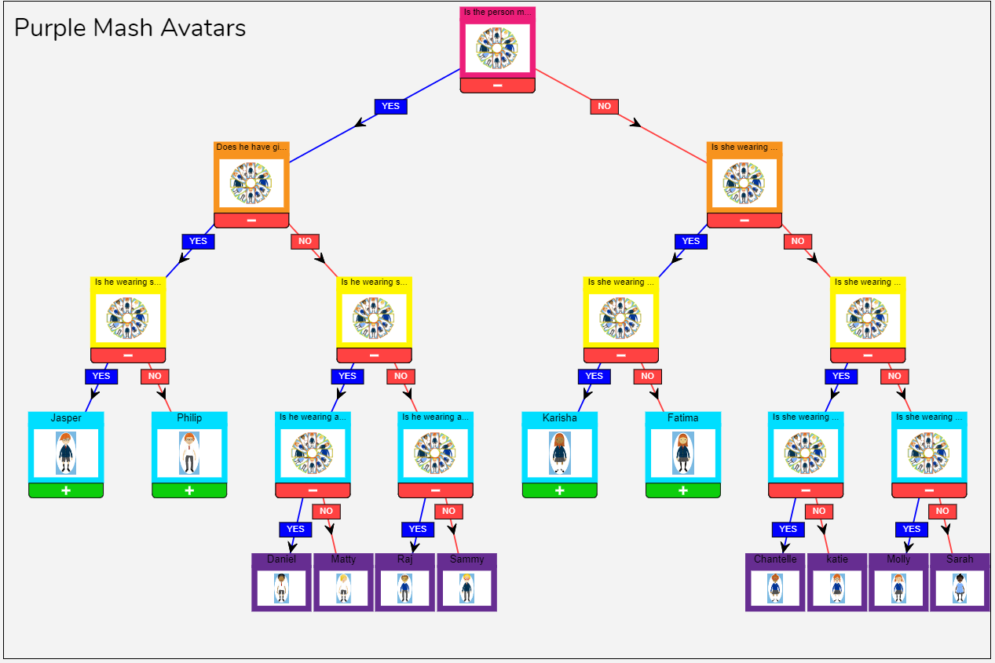
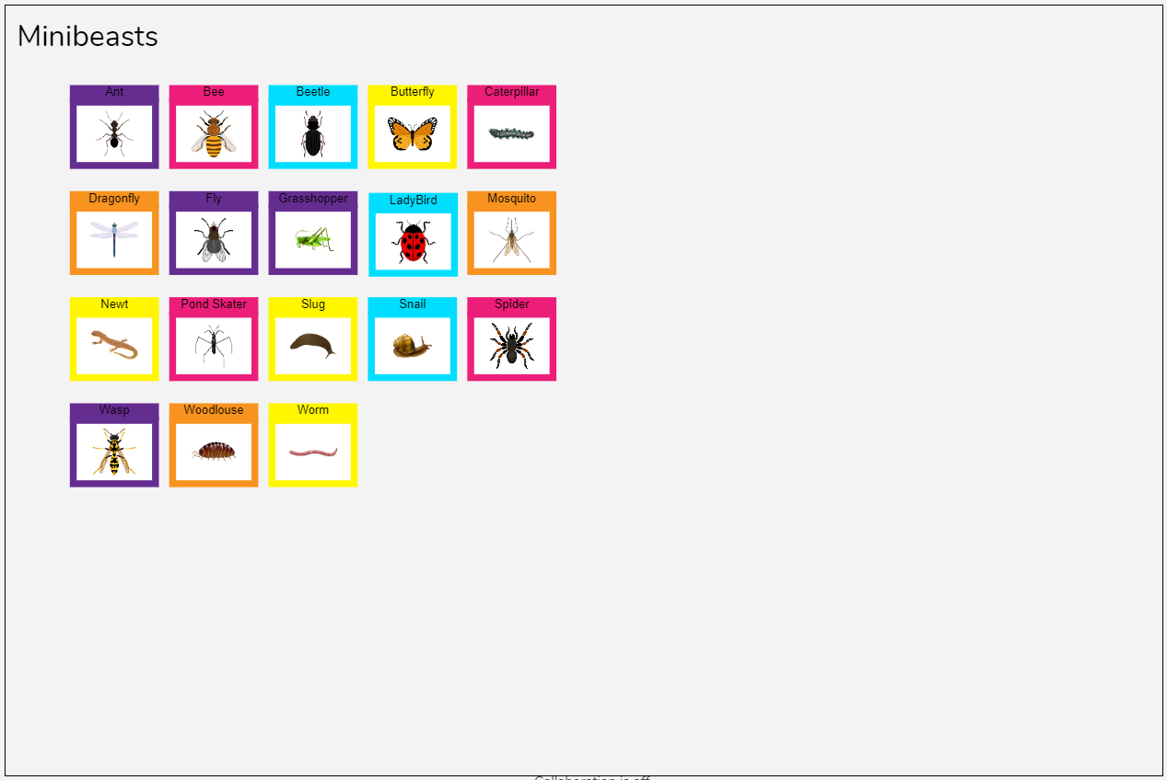
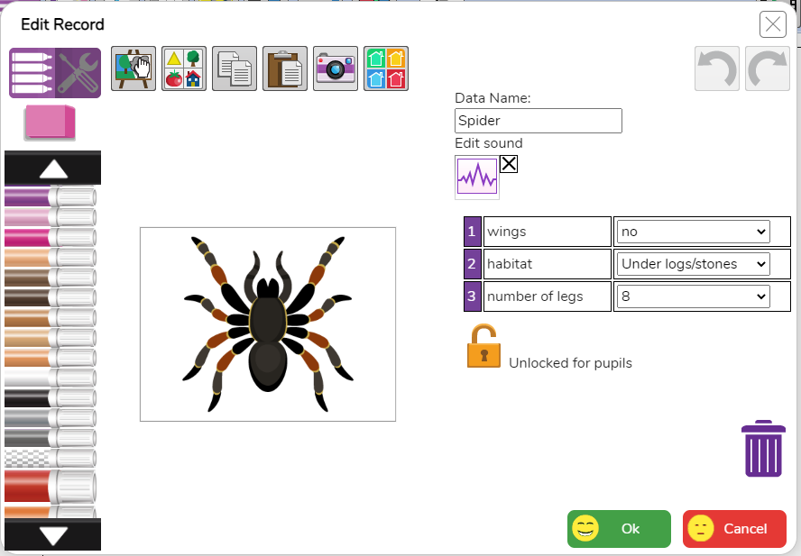
What is a Database?
A database is a set of data that can be held in a computer in a format that can be searched and sorted for information.
On Purple Mash you might have used 2Question and 2Investigate to do this in the past.
2Question
2Investigate

Slide 4
2Question and 2Investigate
Do you remember what type of database 2Question is?
2Question is a branching database (or binary database).
It is limited in that you can only sort information using YES and NO questions.
2Investigate allows you to sort information using more than one field.
Need more support? Contact us:
Tel: +44(0)208 203 1781 | Email: support@2simple.com | Twitter: @2simplesoftware
Notes:
Can children answer the questions on slides 4-5?
Children were introduced to databases in unit 2.4 and 3.6.
Clicking reveals the answers and further information.

Slide 5
Vocabulary
A Record
A collection of data about one item entered into a database.
Fields
The basic units of data storage: Each field contains information relating to one aspect or attribute of the record.
Notes:
Use slide 6 to clarify the vocabulary that will be used.

Slide 6
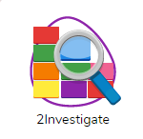
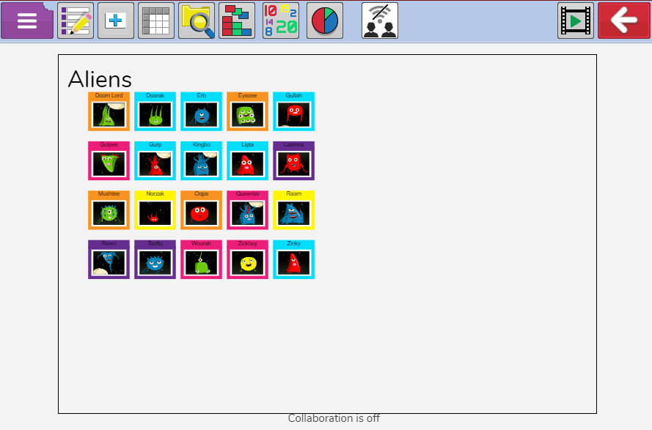
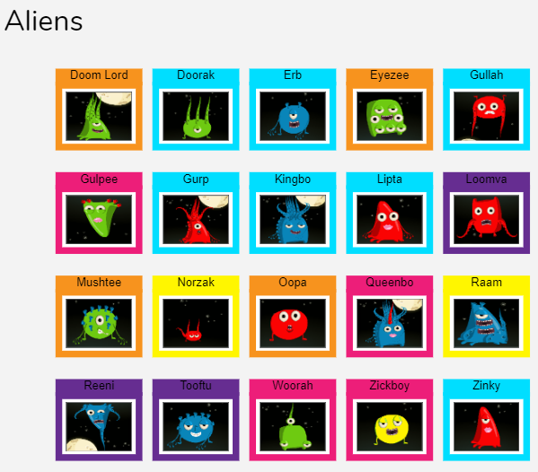
2Investigate Alien Database
Open the 2Investigate database ‘Aliens’.
This is accessed by opening the 2Investigate tool and clicking the aliens icon on the first screen then
Notes:
Open up the Aliens Database.

Slide 7
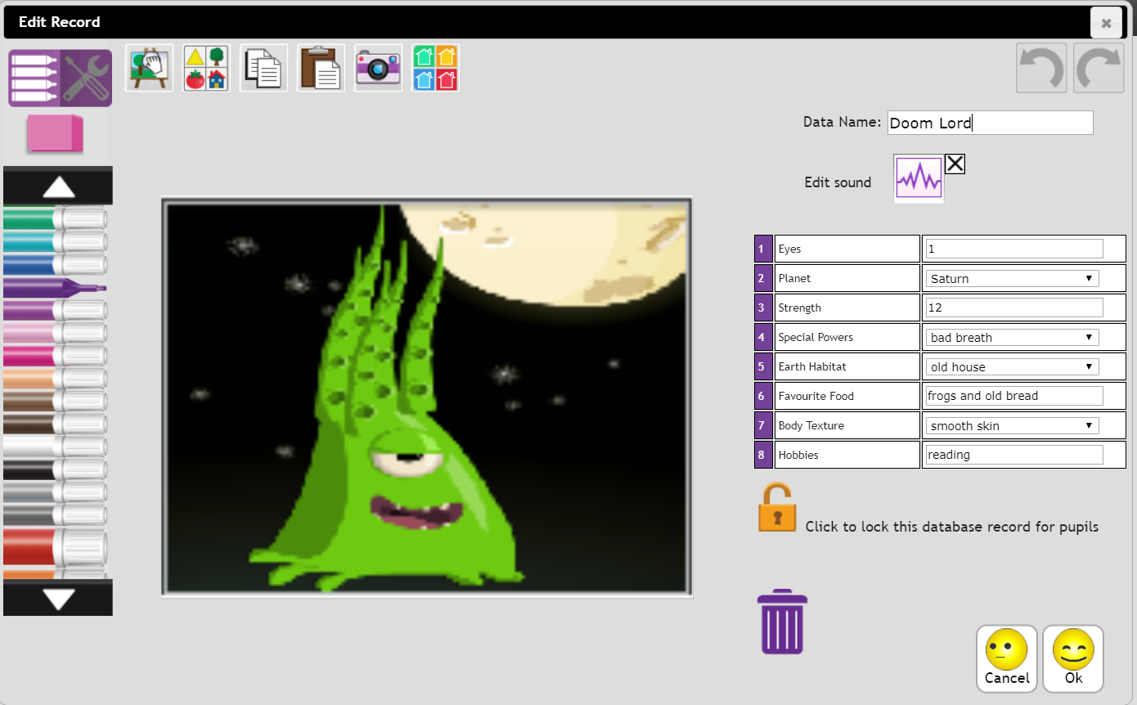
2Investigate
Click on one of the records, e.g. Doom Lord.
Look at how the information is entered on a database:
Some fields are free text (typed in) e.g. (Favourite Food, Hobbies).
Some fields are numbers (Strength, Eyes).
Other fields have drop-down menus with restricted choices (Planet, Special Powers, Earth Habitat and Body Texture).
Q: Why do the you think that drop-down entries are useful?
A: Using them saves time typing. It also stops typing errors, this makes searching the database more accurate.
Notes:
Focus on Find (searches) for this lesson.

Slide 8
Sorting and Searching a Database
Each of the following slides relates to a different way to search or sort the data within the database.
Table
Find
Sort, Group, Arrange
Statistics and Reports
Charts
Notes:
Focus on Find (searches) for this lesson.

Slide 9
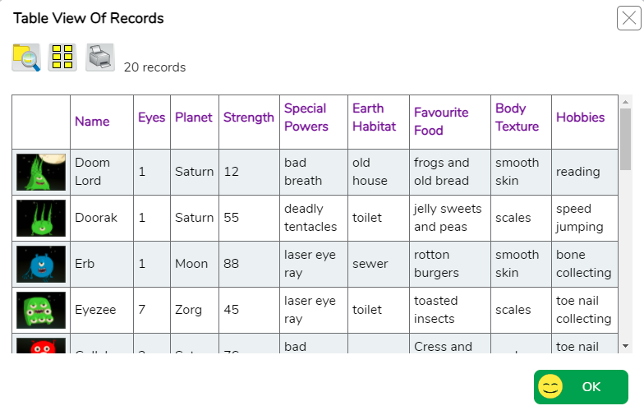
Table
The Table View icon at the top of the screen allows you to sort the information in the database into a table.
You can search* the data in table view and the table will only display the required records.
Click on a field name to sort the data alphabetically or numerically.
Click here to view all records again.
*See the Find slide (11) for details.

Slide 10
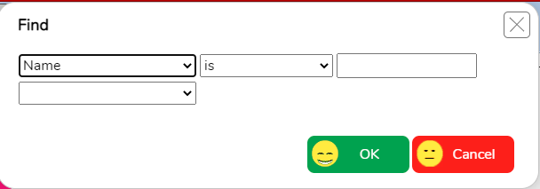
Find (searches)
The Find icon allows the user to search for information in a record.
See if you can ‘read’ what the following examples do. Click to see the answers and further questions.
Aliens with 4 eyes.
Aliens from the planet Boaz.
Aliens who do not like fishing.
Aliens from the moon who have scales.
Aliens who either have more than 2 eyes or deadly tentacles or both.
When you search, the matching records will move to the middle of the screen. The non-matching records will be at the bottom. You can use the speed slider to set the sorting speed.

Slide 11
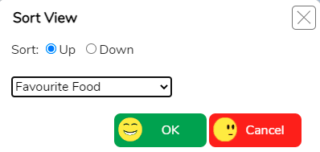
Sort, Group and Arrange
The Sort, Group, Arrange icon allows you to sort the information in several different ways.
Sort
You can sort by different fields. The information can be displayed in ascending or descending order. Here the user is sorting by number of eyes.

Slide 12
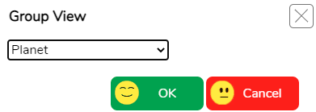
Sort, Group and Arrange
Group
You can group records together according to shared information. Here is an example of sorting the aliens according to the planet they come from.

Slide 13
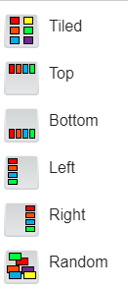
Sort, Group and Arrange
Arrange
You can display the records in several different ways:

Slide 14
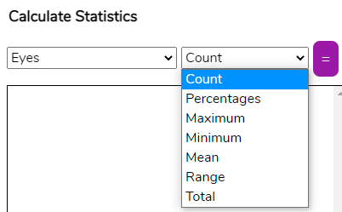
Statistics and Reports
Use the Statistics and Report icon to analyse the data.
Statistics
The information the user can display will depend on the type of field. In this instance, the user is finding statistical information about eyes.
Count – displays a count of how many records have each number of eyes.
Percentage – displays what percentage of records have each number of eyes.
Click on the = button to calculate the statistics. You can then Clear this or
keep adding to the statistics list.
Maximum \ Minimum \ Mean \ Range – calculates the selected answer for the field.
Total – adds up the total for that field e.g. the total number of eyes of all the aliens.

Slide 15
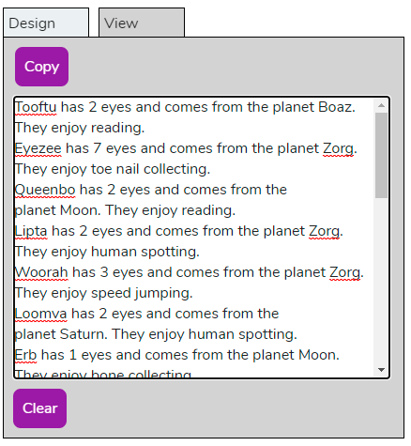
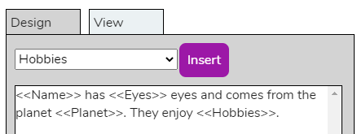
Statistics and Reports
Reports
You can produce a report that includes your own text and the data from the database.
Here is a report with name, number of eyes and home planet.
Press View to see the report. This information can then be copied.

Slide 16
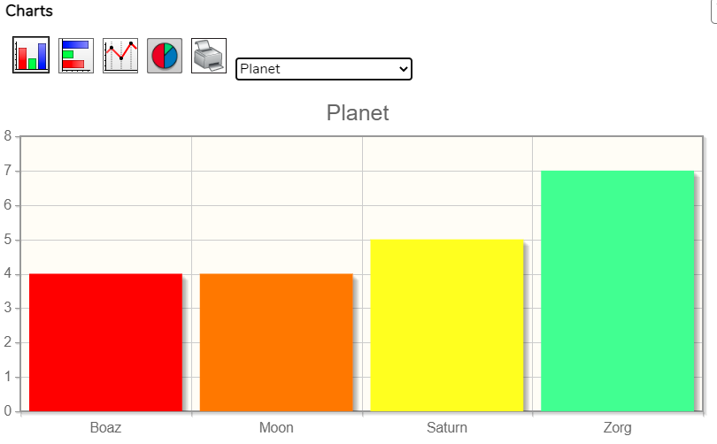
Charts
The chart icon allows you to show the information in chart form.
There are a variety of different charts to choose from:
Select the field of the data that you wish to display in the drop-down box.

Slide 17
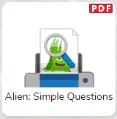
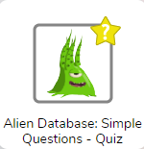
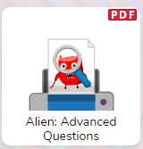
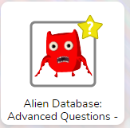
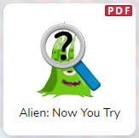
Activity 1
1) Choose your challenge level – Simple for less confident. Advanced for more confident. Complete the worksheets depending on your challenge level. Use Purple Mash to access the database or use the paper sheet instead.
2) You will also have the chance to create your own questions for a friends to answer.
Notes:
Children should spend time using 2Investigate to answer the questions.
Children could share some of the questions that they created and see whether the class can answer them.

Slide 18
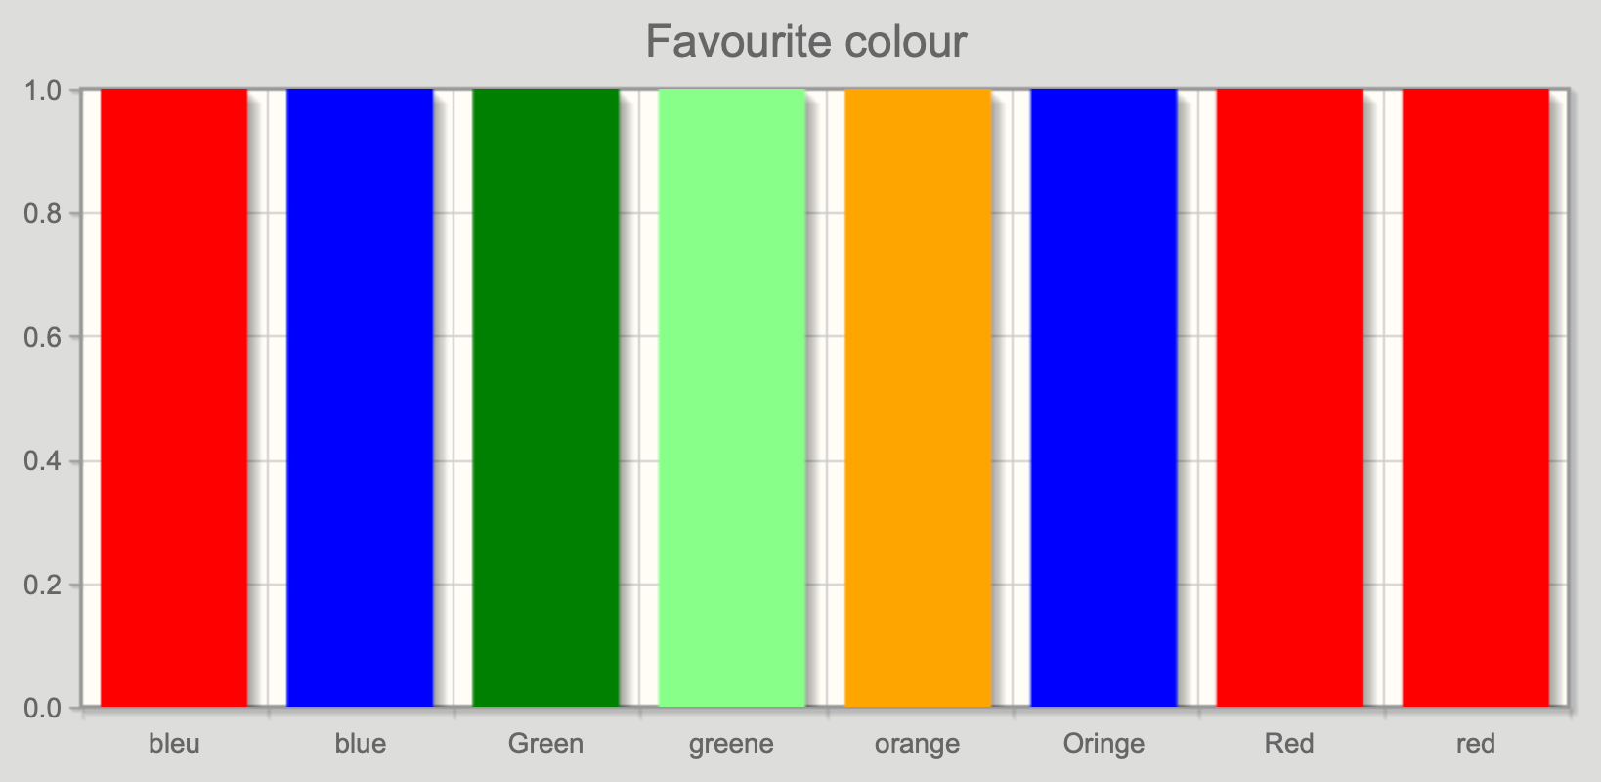
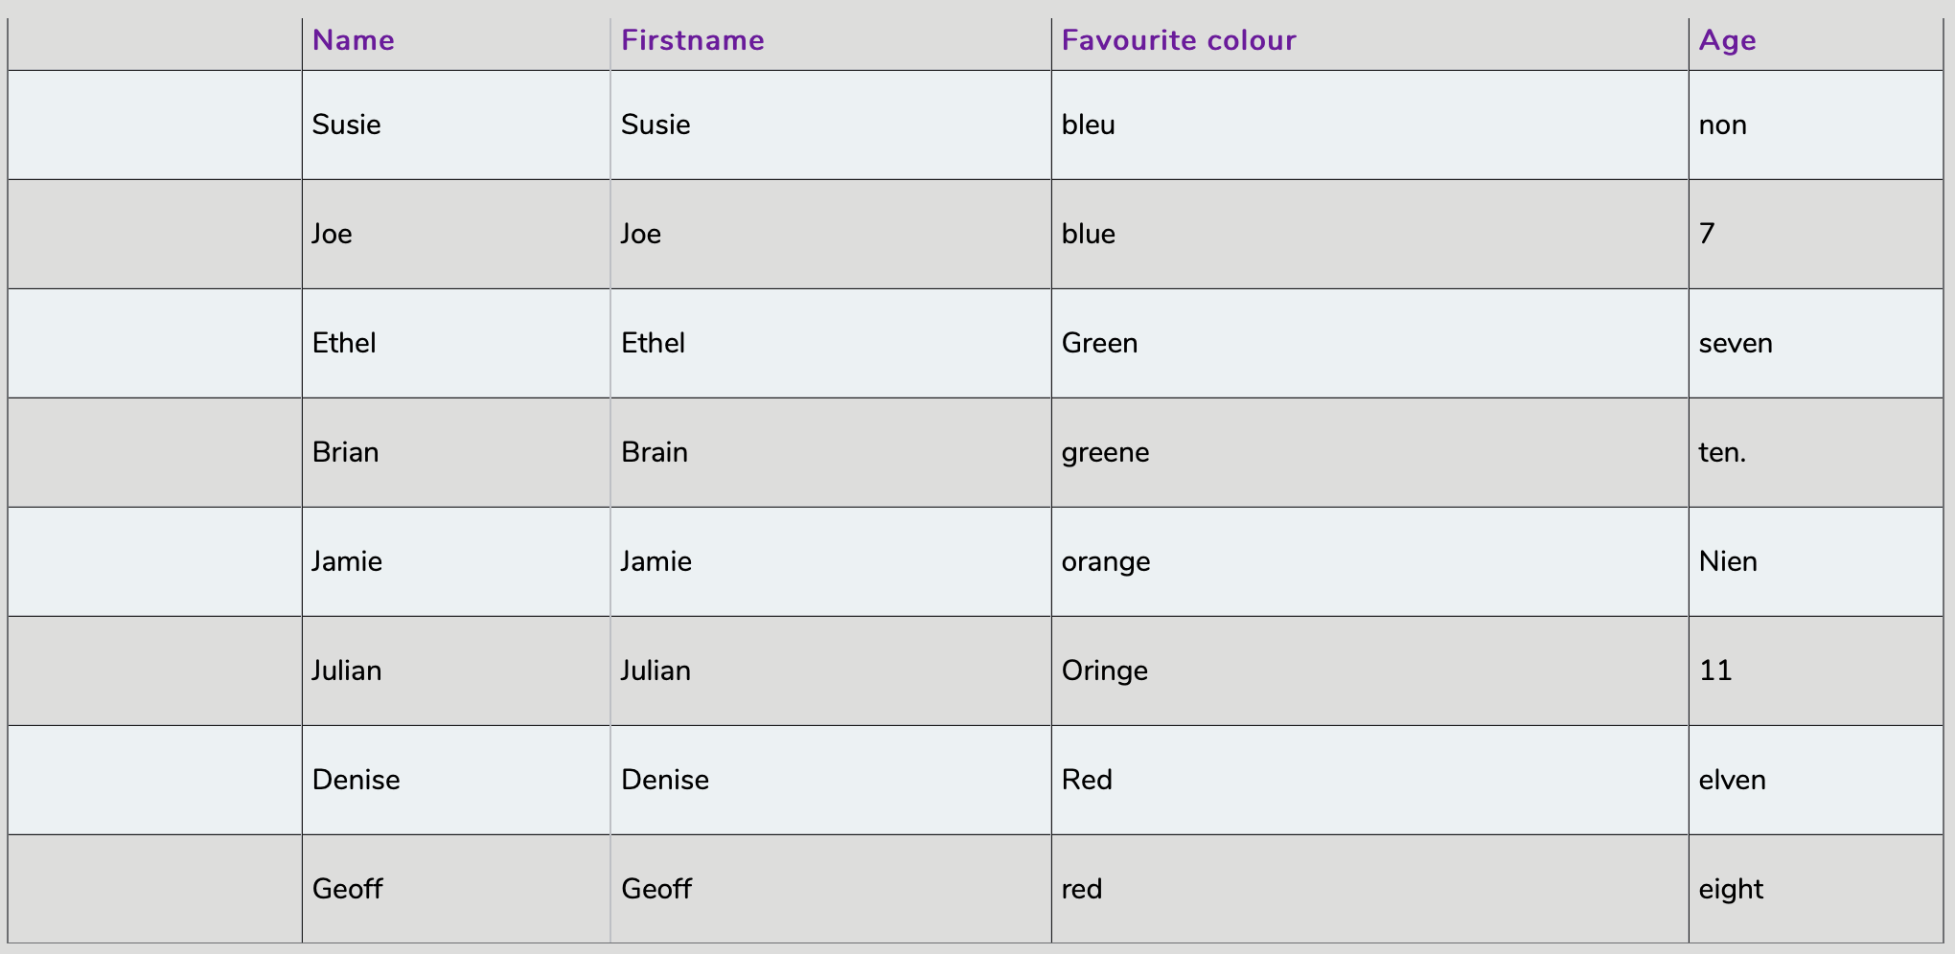
Activity 2: Extension – Debug the Data
Look at the database table below: This database was created recently in another school but doesn’t seem to work properly, because when the ‘favourite colour’ graph was looked at it seemed very strange.
Why has this happened?
What could the database creator have done to avoid this problem?
Can you design a ‘How to make your database great’ poster, using the template set as a 2Do? Include lots of top tips such as:
• Why spellings are important?
• Are field names clear and understandable?
• Have drop-down menus been used effectively?
• Are image choices relevant?
• Can questions set be answered from the data within the database?

