Slide 1
English
Week 3 Lesson 1

Slide 2
Grammar – Higher level conjunctions
Brainstorm all conjunctions you can think of. NOT ‘and’, ‘because’, ‘but’, ‘so’

Slide 3
Grammar - conjunctions
Coordinating conjunctions are used to link together two words, phrases or independent/main clauses. Coordinating conjunctions are often called FANBOYS conjunctions, as the main ones are: for, and, nor, but, or, yet or so.
A subordinating conjunction is a part of a sentence that adds additional information to the main clause. A subordinating conjunction is simply the word/words that is used to join a subordinating clause (doesn’t makes sense on its own) to another clause or sentence.

Slide 4
Grammar task
Complete the sentences using conjunctions. The conjunction can go at the start or end of the sentence.
I went to the beach.
The train slowed down.
I wrapped up warm.
We switched on our torches.
It was snowing.
Susan jumped for joy.

Slide 5
LO: To be able to note take.
SUCCESS CRITERIA
1) I can choose my person of interest.
2) I can find relevant facts.
3) I can record facts in note form.
Extension:
4) I can group facts into topics.
Challenge: I can say what my person’s legacy is.

Slide 6
English
Week 3 lesson 2

Slide 7
Grammar - conjunction
What are conjunctions?
What types of conjunctions are there?
What examples of conjunctions can you think of?

Slide 8
Grammar – identify the conjunction in the sentences.
Say whether it is a subordinating or coordinating conjunction.
Before folding your clothes, make sure they are dry.
Make sure to turn the oven off if it gets too hot.
Although it is raining, we are still going on our walk.
Don’t paddleboard on the waves until they have calmed down.
You can go to the park or you can stay at home.
Tina often gets seasick, yet she has decided to get the ferry.
EXT: Now write some sentences of your own. Underline the conjunction and say what type it is.

Slide 9
LO- to be able to plan a biography
SUCCESS CRITERIA:
1) I can put relevant information into each box on my planning sheet.
2) I can compose a relevant rhetorical question.
3) I can create a sense of time order using my plan.
4) I can create lively linking phrases.
EXTENSION:
5) I can compose some reported/ direct speech.
CHALLENGE: I can ensure that there is plenty of different information/ facts on my planning sheet.

Slide 10
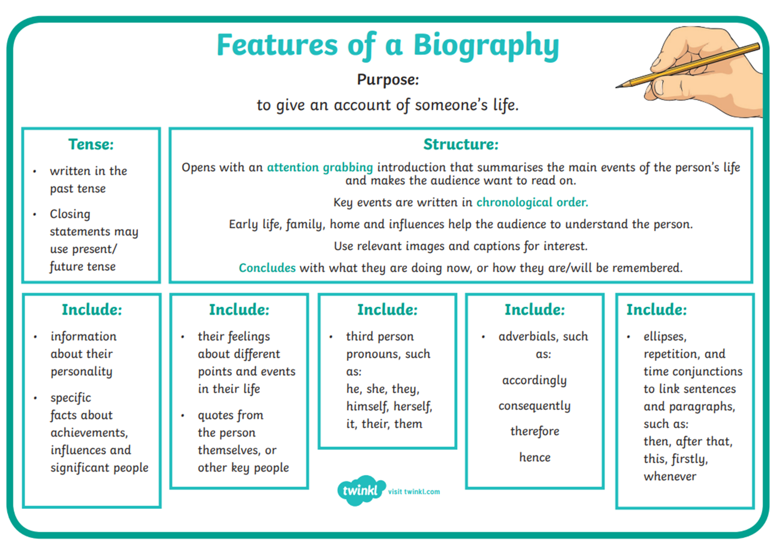
What is a biography?

Slide 11
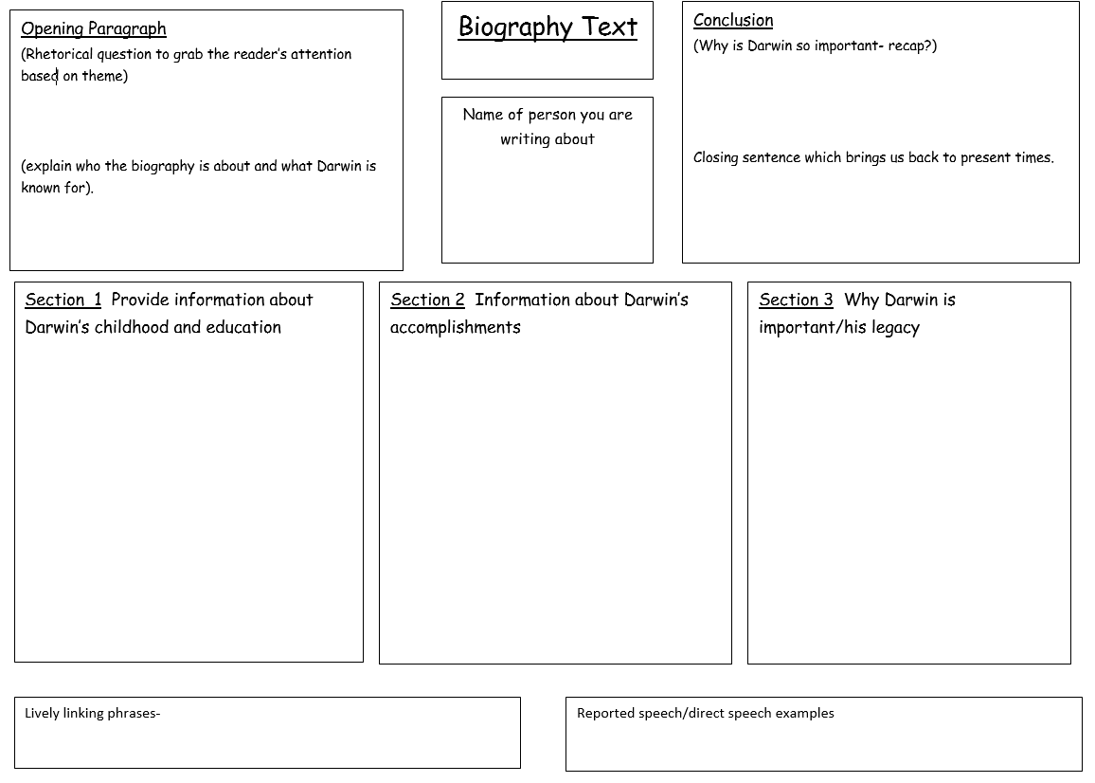

Slide 12
English
Week 3 lesson 3

Slide 13
LO- to be able to write a biography. (independent write)
Write your own success criteria.
Think about what is needed in your biography.
Think about your personal targets.

