Slide 2
What Is ‘Kindness’?
Kindness is:
without expecting anything in return.
doing something nice for someone else
being concerned when others are upset or worried
helping people when they need you
being friendly, generous and considerate of others
showing goodwill to others
What does ‘kindness’ mean to you?

Slide 3
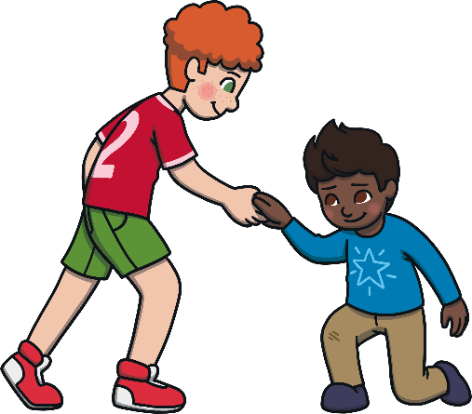
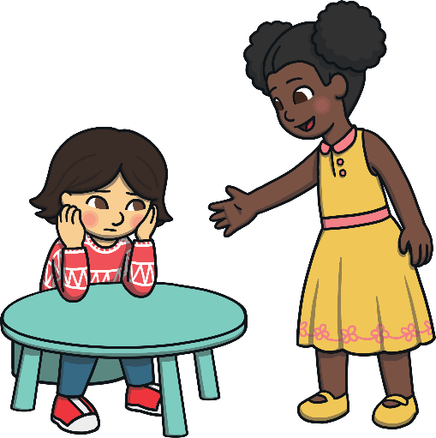
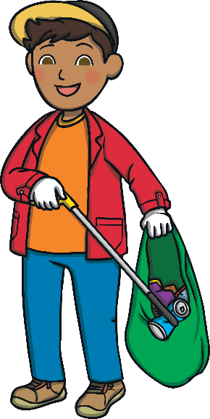
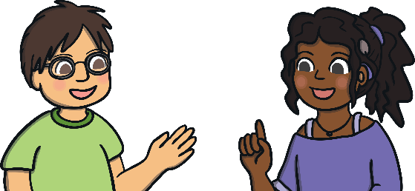
How Can You Show Kindness?
Smile
Help someone if they fall over.
Go and sit with someone who is sitting alone (if they want you to).
Sit next to someone at lunchtime you would not normally sit with.
Ask someone how they are.
Pick up litter.

Slide 4
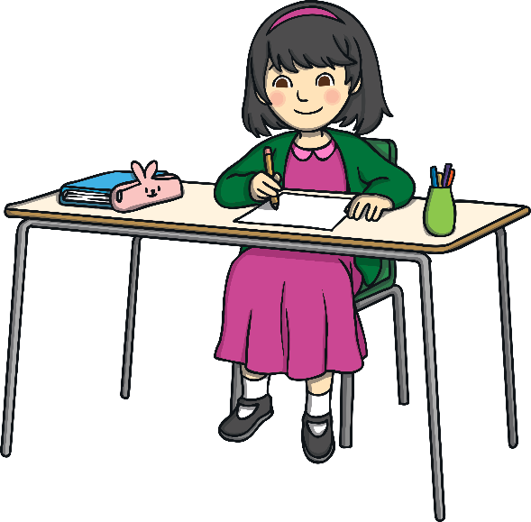
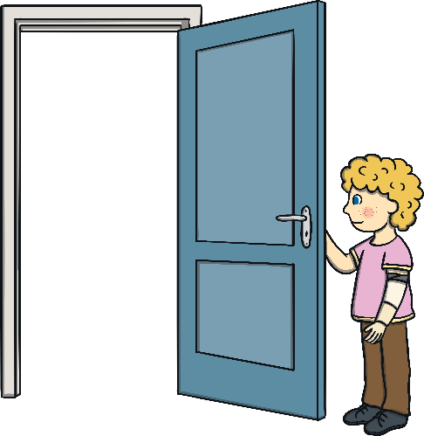
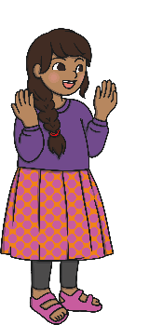
How Can You Show Kindness?
Say good morning.
Write a letter to someone thanking them for something they’ve done or said.
Say something nice to as many people as possible.
Hold doors for others.
Let someone go ahead of you in the line.

Slide 5
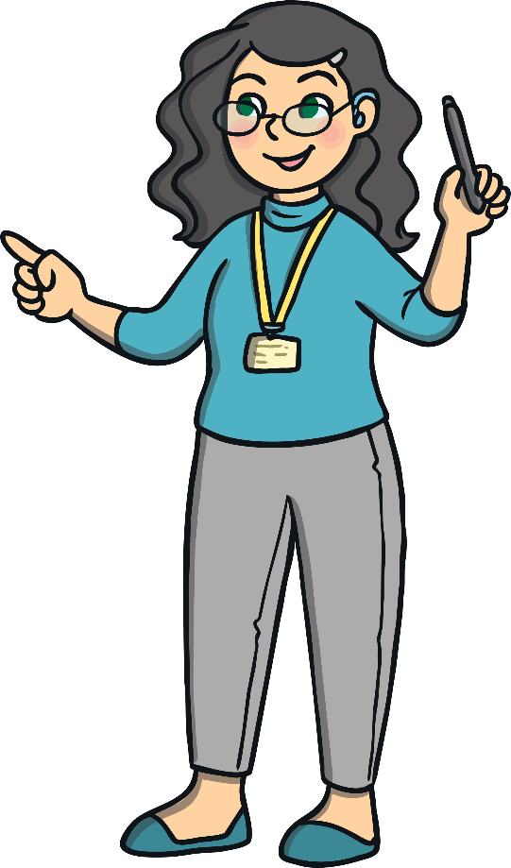
How Does Kindness Help Our School?
Doing kind things for others activates the parts of the brain that make you feel happy.

Slide 6
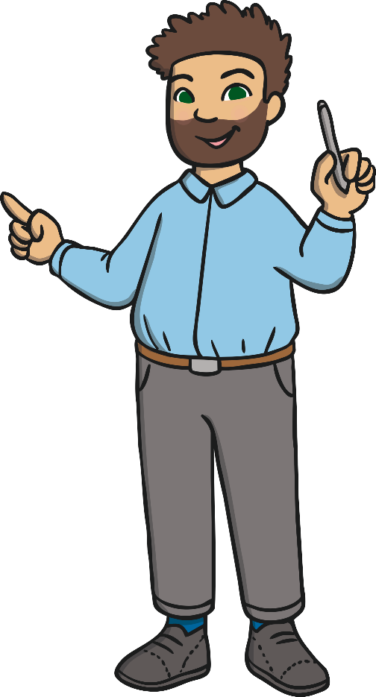
How Does Kindness Help Our School?
Kindness makes people feel that they belong and helps to reduce bullying. Being kind helps you to make friends.

Slide 7
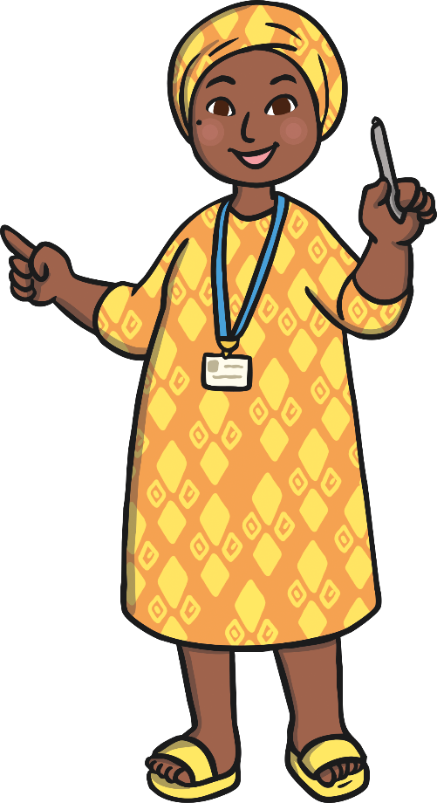
How Does Kindness Help Our School?
Kindness can help you concentrate, as the good chemicals in your brain are released.

Slide 8
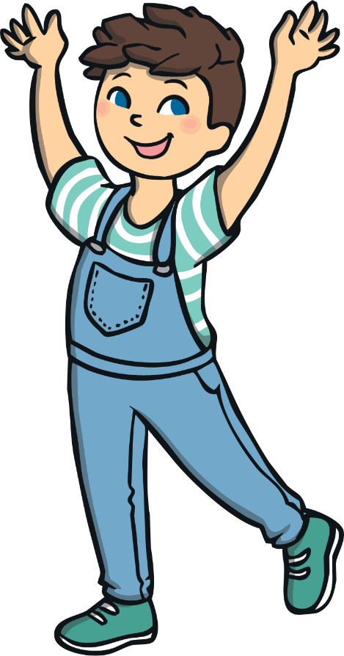
How Does Kindness Help Our School?
Kindness increases our sense of wellbeing.

Slide 9
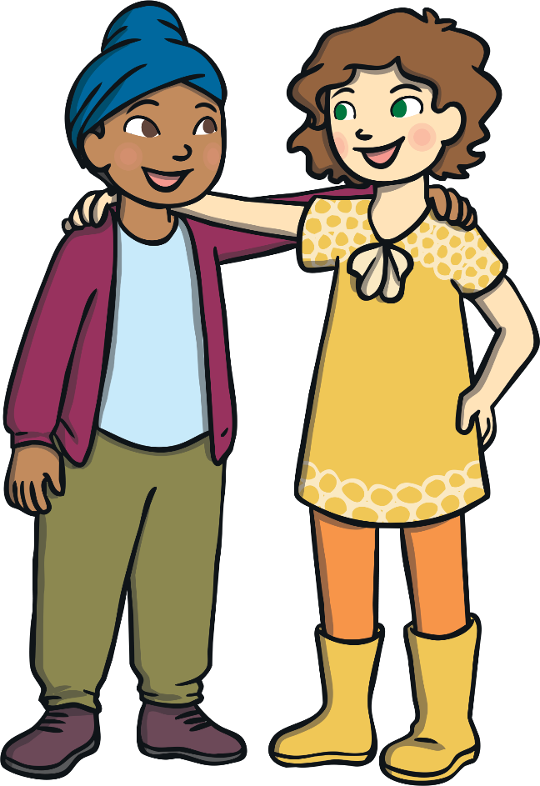
How Does Kindness Help Our School?
Being kind to people encourages them to be kind too.

Slide 10
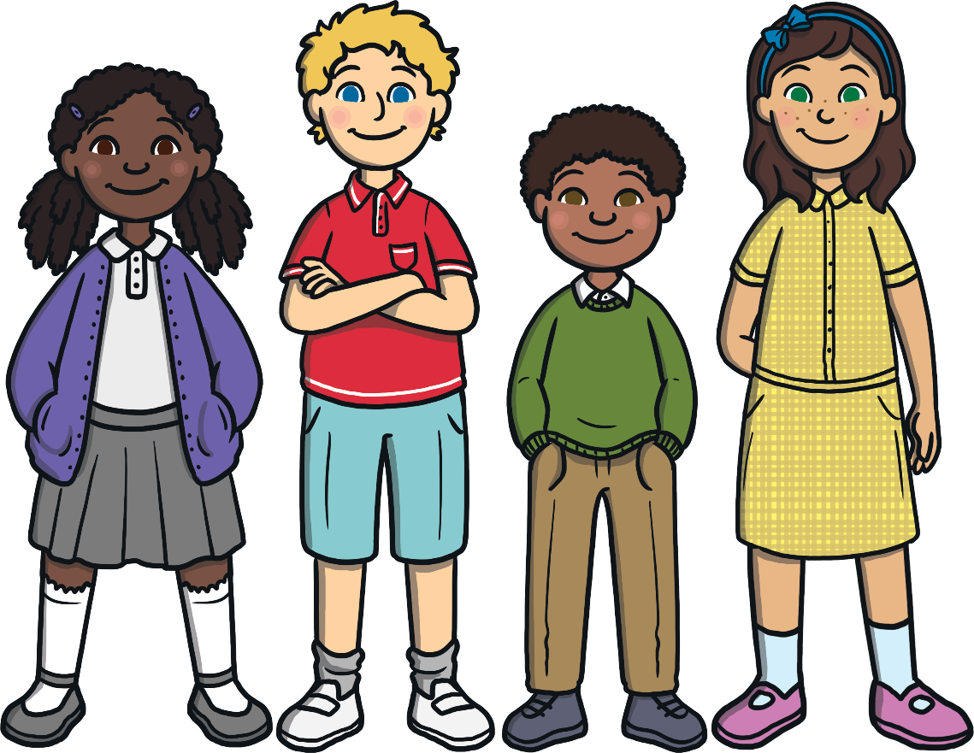
How Does Kindness Help Our School?
Kindness makes our world a better place for everyone!

Slide 11
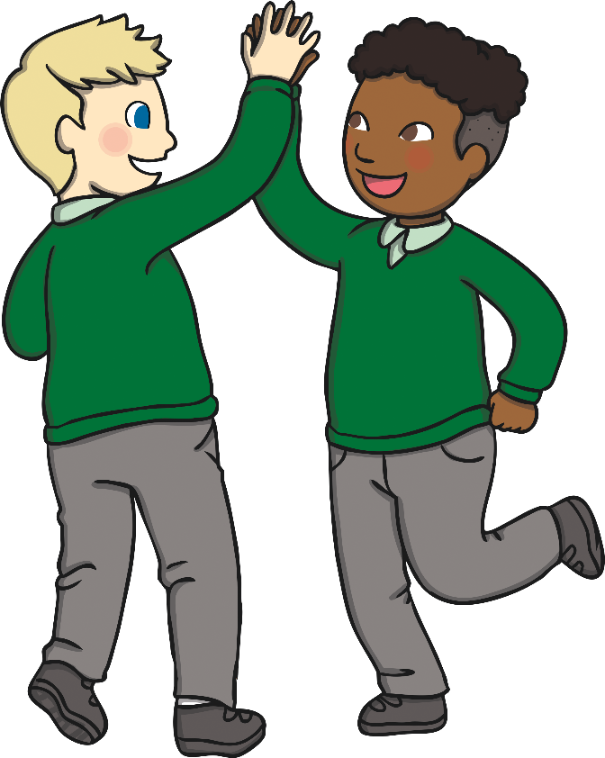
Make the Choice
When you are kind, you make the world a happier, safer place.
You can be kind to everyone - to people who are just like you and to people who are different to you.
Choose kindness!
You have infinite kindness in you - share it with everyone, every day.

Slide 12
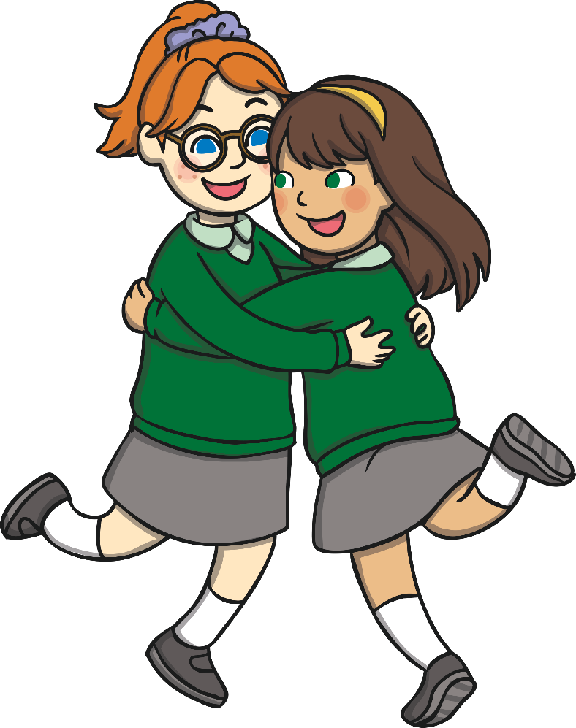
Make the Choice
Your smile might be the brightest light in someone’s day, so let your kindness shine - smile at whoever you can, whenever you can.
Choose kindness!

Slide 13
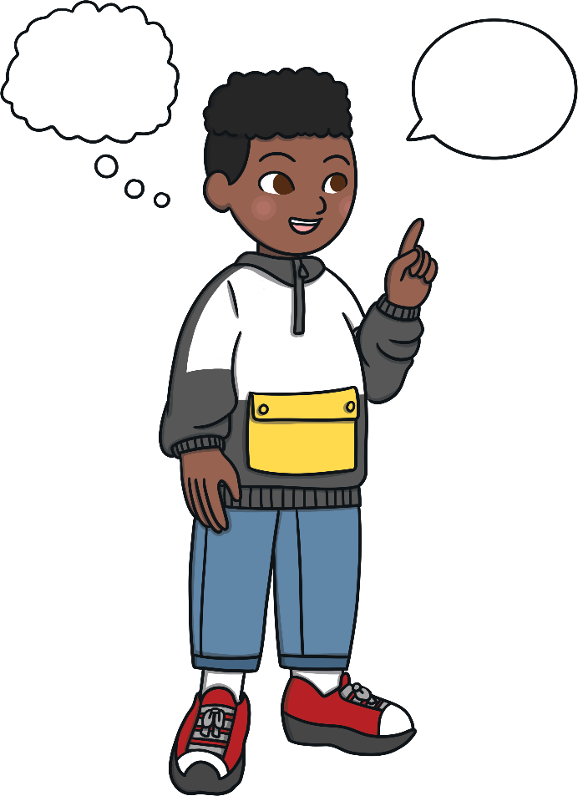
Talk About it…
Have you talked with thoughtful, caring words today?

Slide 14
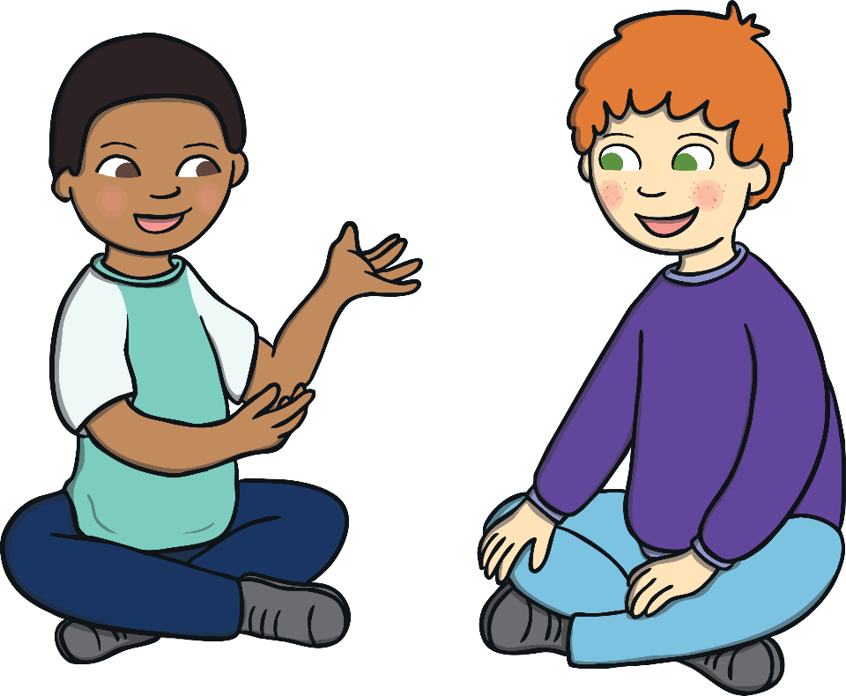
Talk About it…
Have you shown understanding of someone’s feelings today?

Slide 15
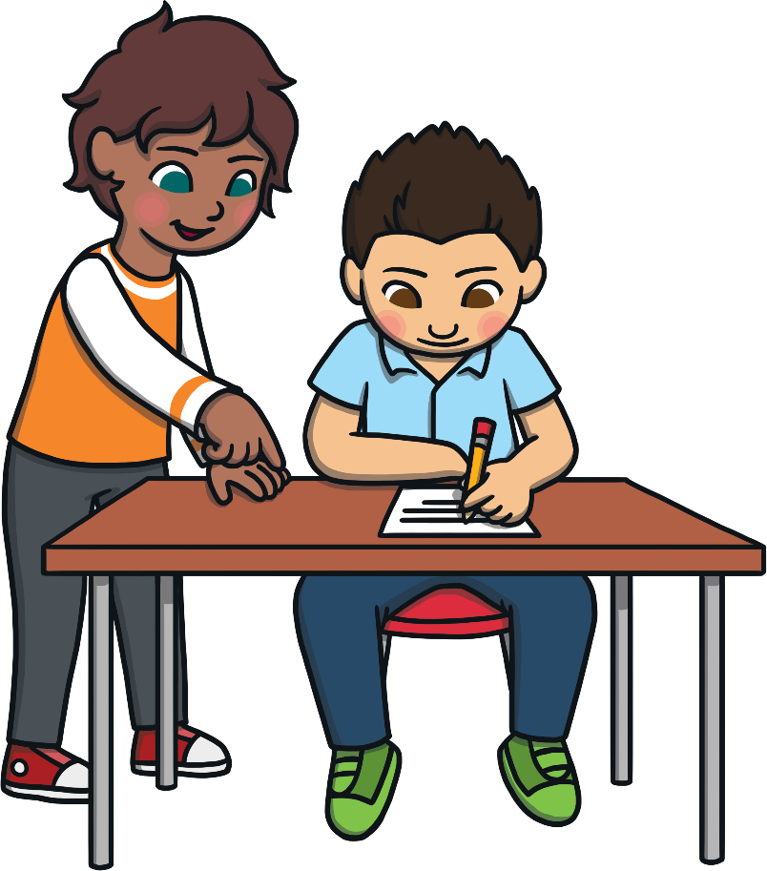
Talk About it…
Have you helped someone today?

Slide 16
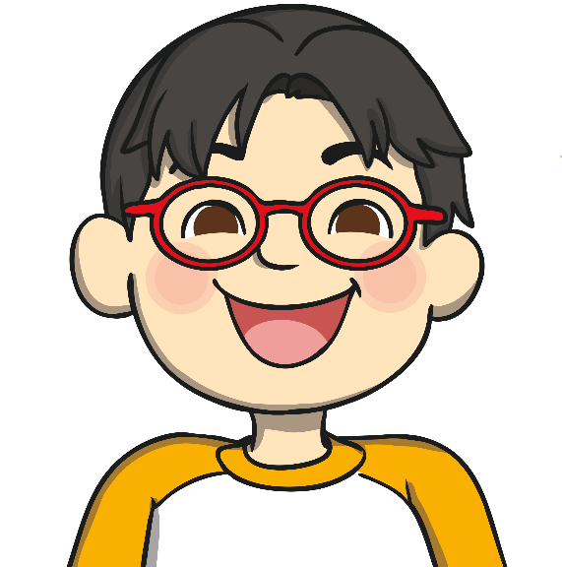
Kindness Day
Today, our school will be taking part in Kindness Day.
However, kindness doesn’t end there! Let’s be kind all year round, both within our school and at home.
We will be doing activities to encourage people to be kind to each other and sharing what we’ve done at the end of the day.
Let’s make our world a better place through kindness.

Slide 17
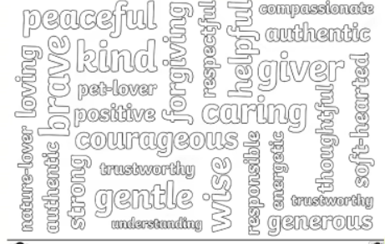
Activity
Complete the kindness wheel worksheet.
Create a word art poster full of different kind words

