Slide 1
Lesson 2:
Computing Scheme of Work Unit 5.4 – Databases
Creating a Class Database
Notes:
Unless otherwise stated, all resources can be found on the main unit 5.4 page.. From here, click on the icon to set a resource as a 2Do for your class. Use the links below to preview the resources; right-click on the link and ‘open in new tab’ so you don’t lose this page.
Prior to the lesson ensure that you know how to create a collaborative 2Investigate database, see the 2Investigate User Guide for more information.
Purple Mash avatar creator: this is accessed by logging on to Purple Mash and clicking on the avatar image in the top right corner.

Slide 2
LO: To create a class database
SUCCESS CRITERIA
Children can design an avatar for a class database.
Children can successfully enter information into a class database.
Notes:
Display slide 2 and outline the lesson aims.

Slide 3
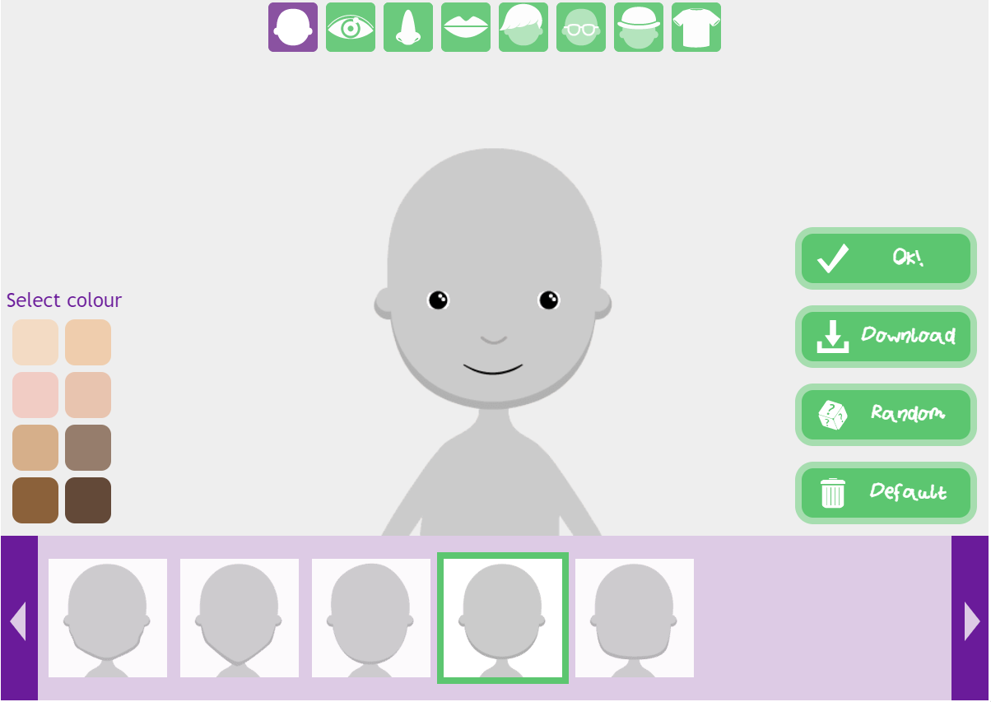
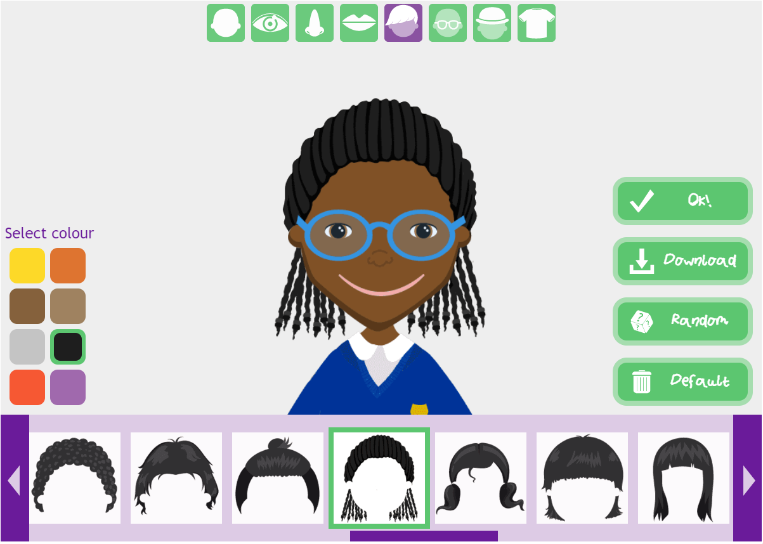
Activity 1: Creating an Avatar
Slide 4
What is an avatar and why might you use one?
An avatar is an image that represents you. You might use one to preserve your privacy and online safety.
To open the Purple Mash avatar creator, click on the avatar icon at the top of the Purple Mash screen.
You can make your avatar using a range of designs.
When you are happy with your avatar, click OK.
Notes:
Use slide 4 to show children how to create their avatars.
Give them time to complete this before moving on.

Slide 4
A Class Database
Look at your avatar. What information could we record about the images as database fields?
Examples:
Hair colour
Glasses
Headwear
Eye colour
Colour of clothing.
Which of these could be drop-down lists?
Which are numbers and which are text?
What other fields could we also add that are not associated with the image but with the person?
Examples:
Birthday month
Number of siblings
Favourite food
Hobbies.
Notes:
Use slide 5 to decide as a class on the database structure.
Clicking reveals more questions and suggestions.

Slide 5
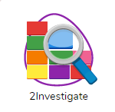
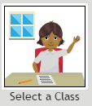
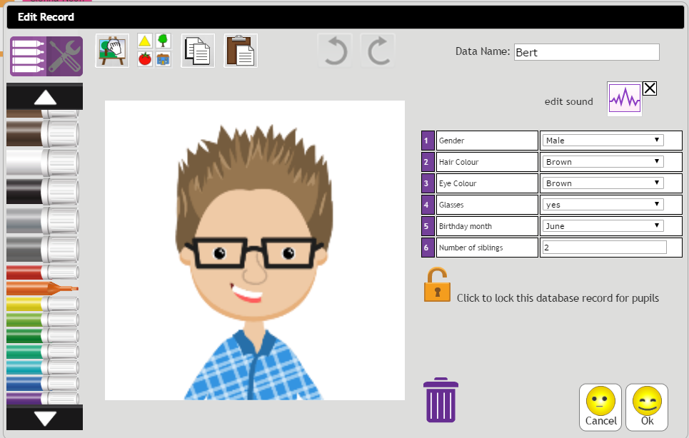
A Class Database
On the front screen of 2Investigate, choose the ‘Select a Class’ database.
When you click the Choose button, you will be prompted to select the class.
This will add a record for each pupil in the class. It will automatically import the avatar images.
Add the required fields that you decided upon.
Notes:
Use slide 6 to set up the database as a class on the whiteboard.
Clicking the icon will open 2Investigate.
Note: The ‘Select a Class’ option is only available for teacher users.

Slide 6
Making the Database Collaborative
What does collaborative mean?
It describes when work is produced by two or more people working together.
A 2Investigate database can be made collaborative. Once it has been made collaborative, the structure cannot be changed, are you happy with the database fields before we do this?
First it needs to be saved in a location which all the people who will collaborate on it, have access to. Where might this be?
The class folder.
Click the collaborative button. This will prompt you to save the file. Do this, adding the word ‘collaborative’ to the filename to make it clear.
Notes:
Use slide 7 to make the database collaborative.

Slide 7
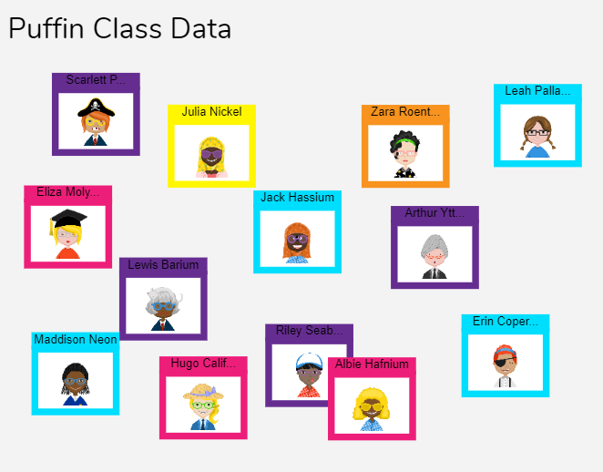
Activity 2: Completing the Database
Complete your own record in the collaborative database.
It will automatically save.
Once all the records are complete, write three questions about the class database for a partner to solve.
Notes:
Use slide 8 to guide the activity where children complete their own record on the collaborative database.

Slide 8
Activity 3: Extension
Create complex questions using AND / OR / IF that might require two fields to be interrogated.
Create a 2Quiz activity for your classmates to complete based on the complex questions.
For example:
“Who has brown hair AND wears glasses?”
“Which children have 2 OR fewer siblings?”
“IF their eye colour is blue, who has a birthday in August?”
Notes:
Use slide 9 to guide an extension activity.

Slide 9
Review Success Criteria
I understand the different ways to search a database.
I can search a database to answer questions correctly.
Notes:
Display slide 10. Review the success criteria from slide 3. Children could rate how well they achieved this using a show of hands.

