Slide 1
Lesson 4:
Computing Scheme of Work Unit 5.2 – Online Safety
Reliability

Slide 2
LO: To know that different forms of communication are reliable and appropriate when used.
Slide 2
SUCCESS CRITERIA
Children show an understanding of the advantages and disadvantages of different forms of communication and when it is appropriate to use each.
Need more support? Contact us:
Tel: +44(0)208 203 1781 | Email: support@2simple.com | Twitter: @2simplesoftware

Slide 3
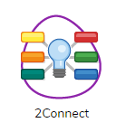
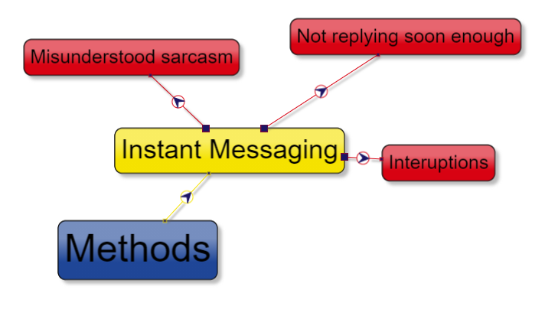
Activity 1: Finding Information
It can be very confusing!
What is the best way of finding out information?
You have been learning about finding out information using the Internet but what about other forms of communication?
Task – create a spider diagram that shows all the different methods of communicating. Feel free to use the 2Connect app on Purple Mash.
Like the diagram below. Use different colours and add nodes to the method nodes with any issues in this form of communication. Here is an example:

Slide 4
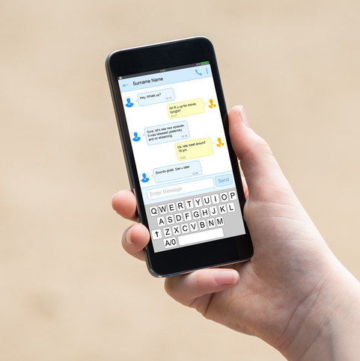
Online or Face-to-Face?
What are these different methods of communication?
Have you used them all?
Are there downsides to any of these methods in your experience?

Slide 5
Online or Face-to-Face?
What emotion does it look like the girl is feeling?
What could have happened here? Notice the phone on the floor.
Has online communication ever made you feel this way?
What advice could you give the girl?
Can it sometimes be useful to stop and think and even ‘sleep on it’ when dealing with a difficult situation?
Do you always need to reply instantly to an instant message?

Slide 6
Online or Face-to-Face?
This slide needs to use the slideshow
You could try role playing this situation face-to-face, would the outcome be different?
Let’s meet up l8r?
Hey, why aren’t you replying?
Abs?
Why r u ignoring me?
Well ,forget it. I didn’t really want to see you.
Don’t bother talking to me in school tomorrow.
How will Abs feel when she leaves the cinema and looks at their phone?
Sorry? Angry? Confused?
Is there anything more that you can now add to the 2Connect file that you started?

Slide 7
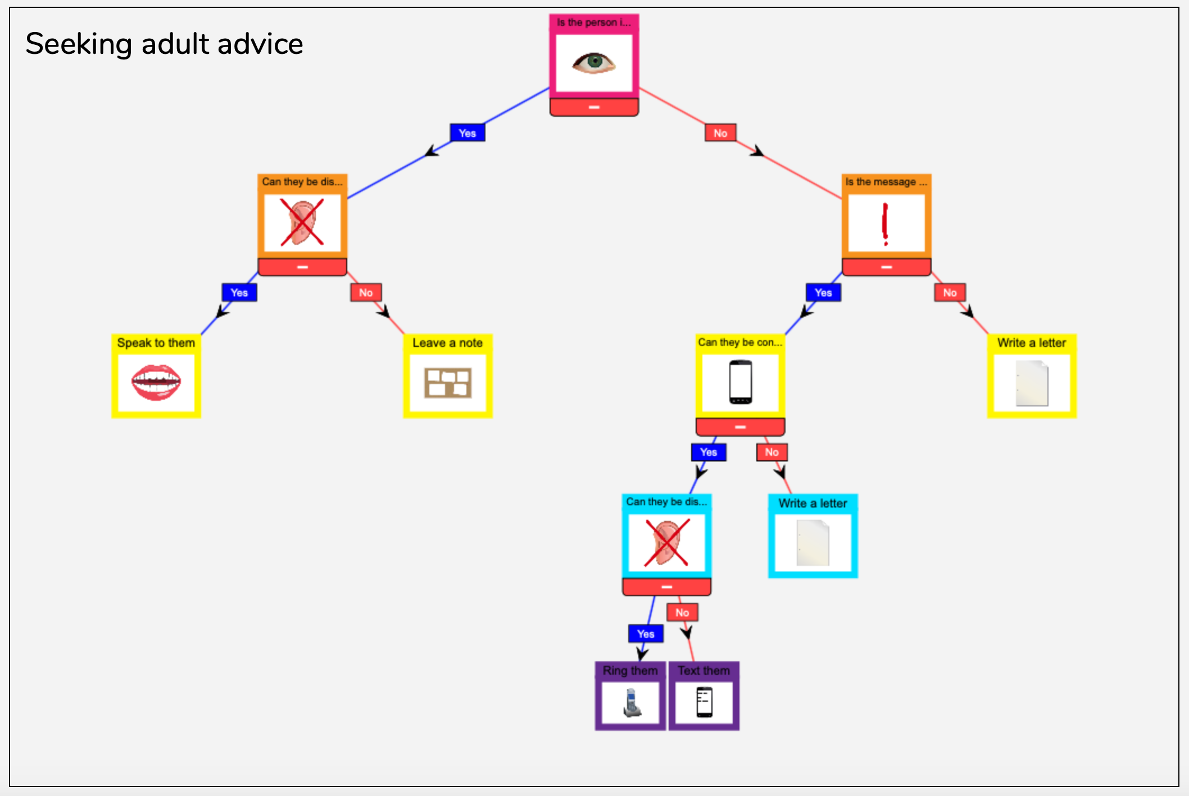
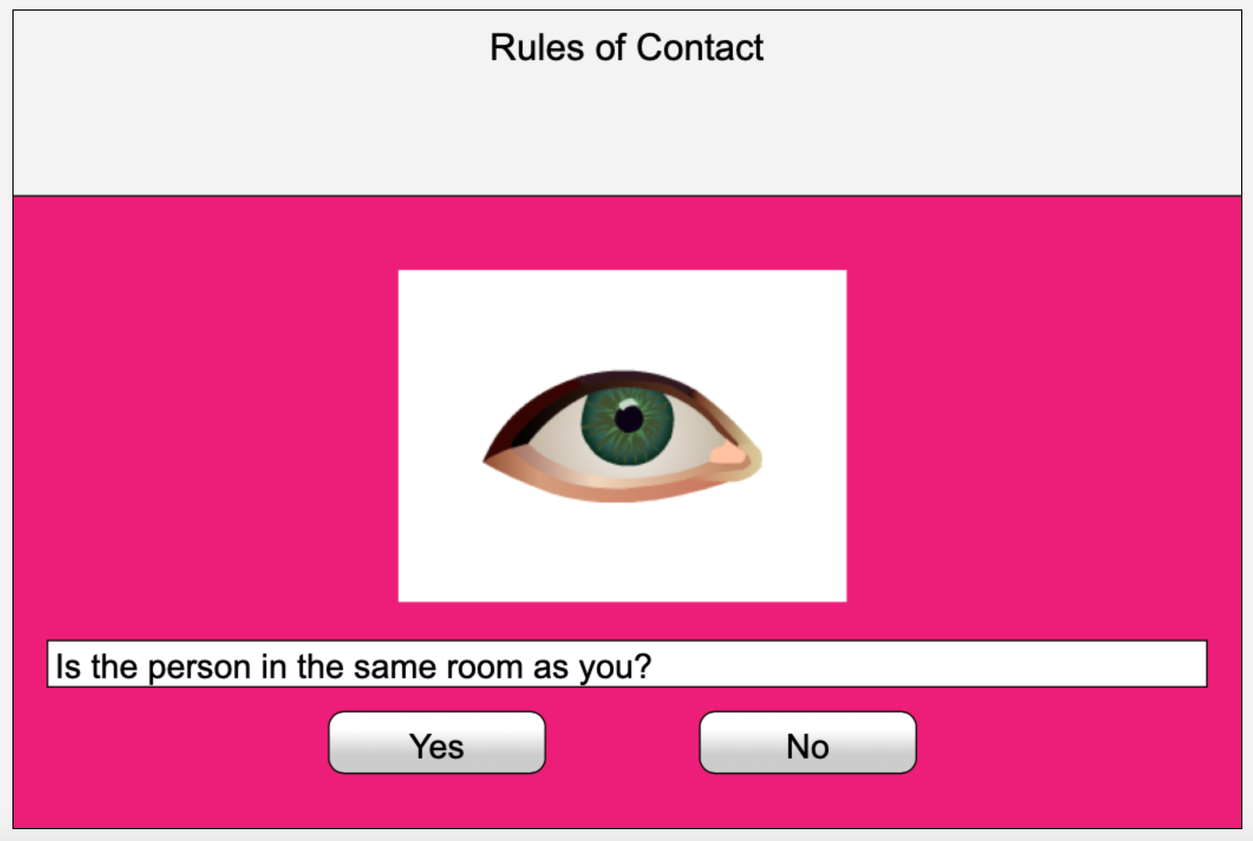
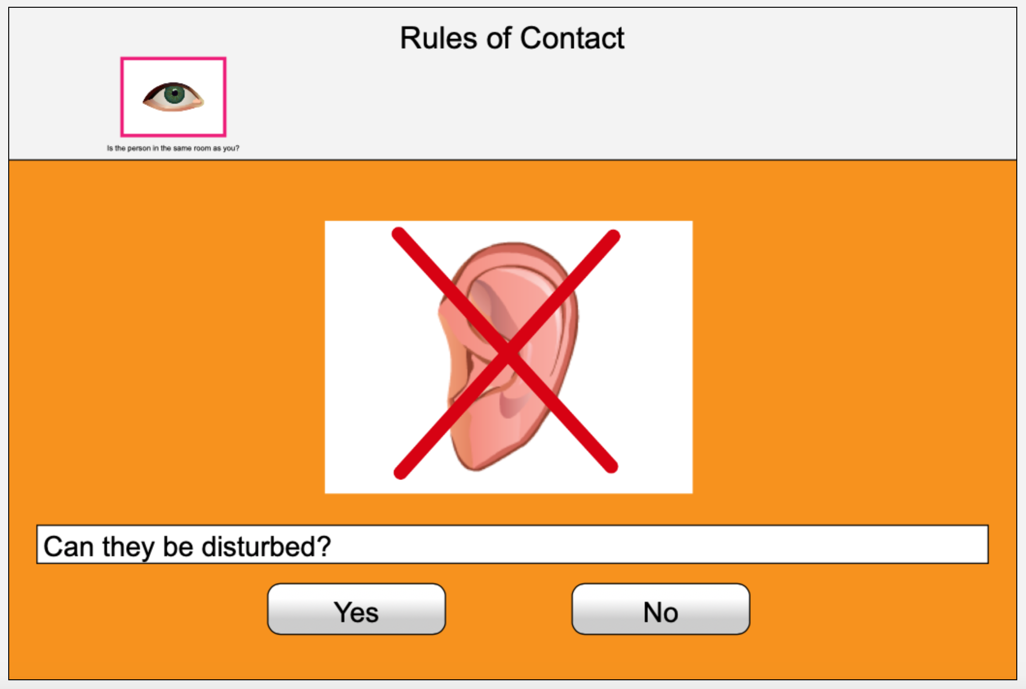
Activity 2: Extension
Slide 9
It can be very confusing!
Open 2Question and create a new branching database that provides a template for the best forms of communication that was discussed earlier in the lesson. Focus on communicating with an adult in different situations.
How can each question be represented by a clear image (i.e. “Can they be disturbed?” might be represented by an ear with a red cross).
Only use images from Purple Mash clipart.

Slide 8
