Slide 1
Lessons 3 & 4:
Computing Scheme of Work Unit 5.4 – Databases
Creating a Topic Database
Notes:
See the lesson plan document for this lesson as there are alternative detailed in it.
• Lesson 3 - 4 – Worksheet

Slide 2
LO: To create a database
Slide 2
Need more support? Contact us:
Tel: +44(0)208 203 1781 | Email: support@2simple.com | Twitter: @2simplesoftware
Notes:
Display slide 2 and outline the aim.

Slide 3
Success Criteria
Slide 3
Children can create their own database on a chosen topic.
Children can add records to their database.
Children know what a database field is and can correctly add field information.
Children understand how to word questions so that they can be effectively answered using a search of their database.
Need more support? Contact us:
Tel: +44(0)208 203 1781 | Email: support@2simple.com | Twitter: @2simplesoftware
Notes:
Display slide 3 and outline the success criteria.

Slide 4
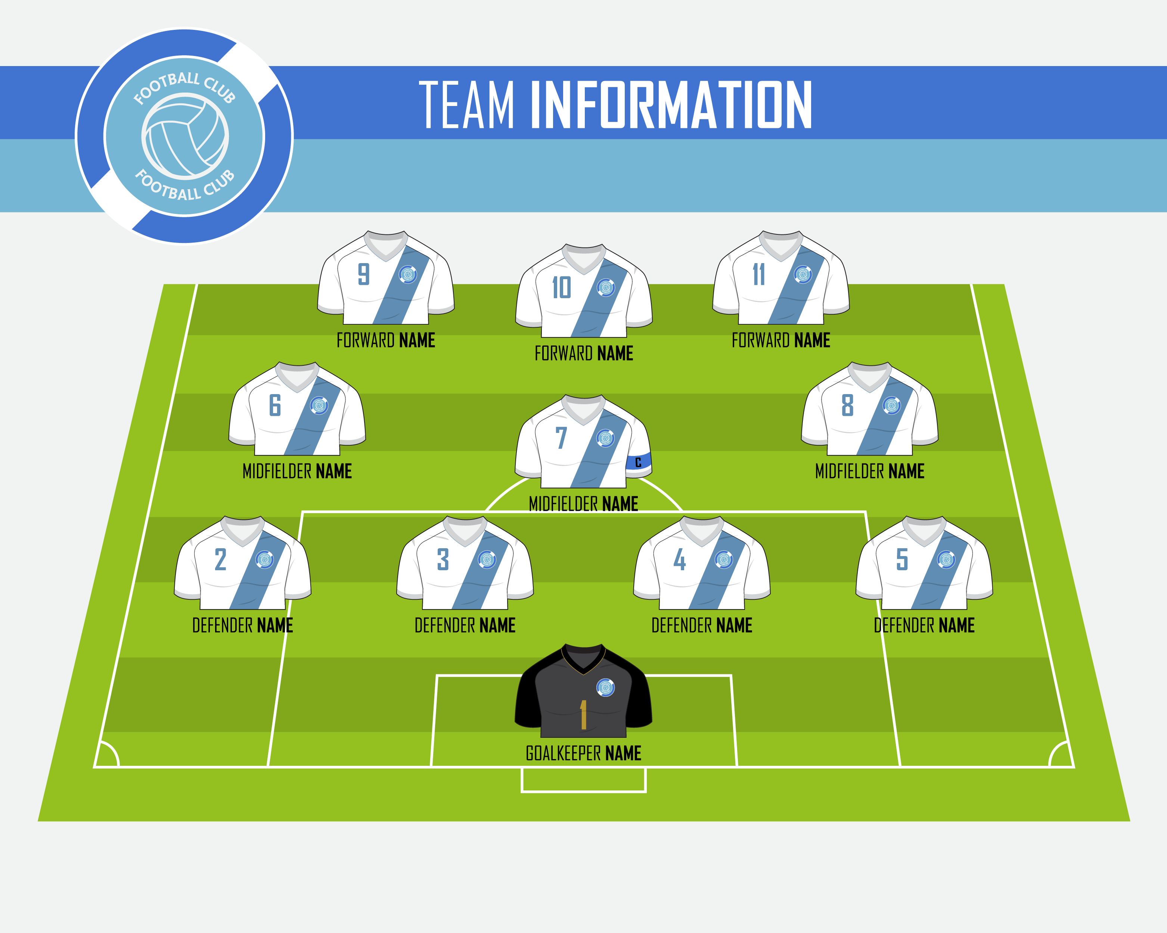
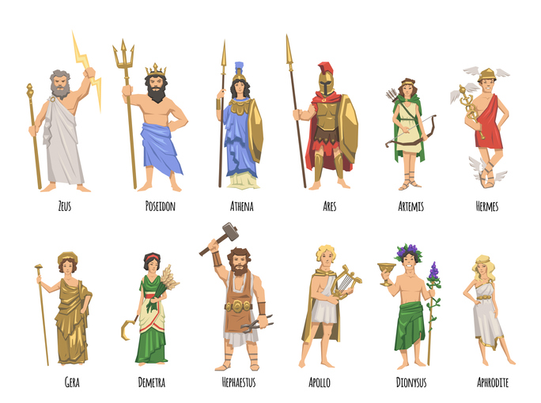
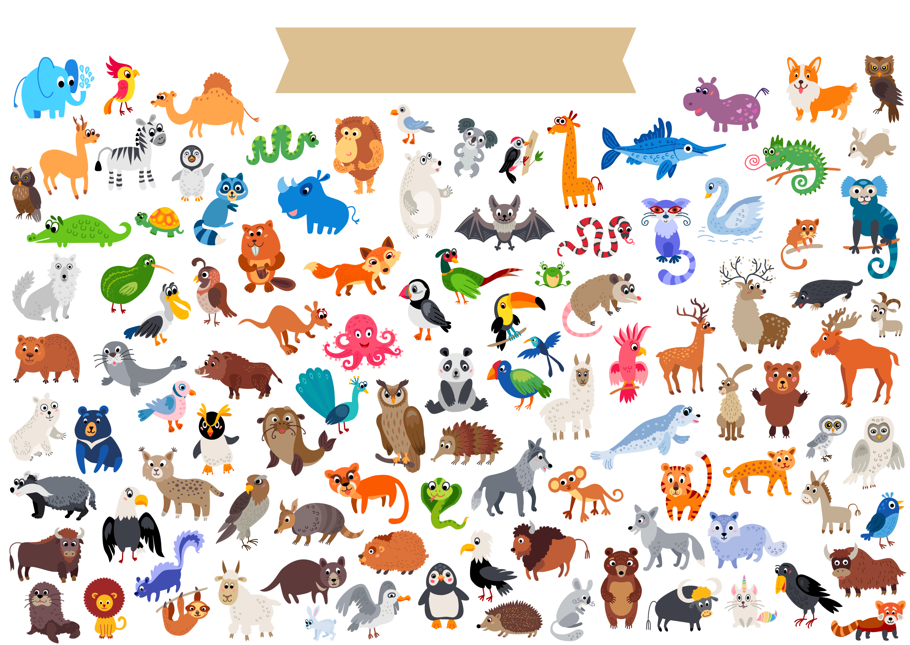
Selecting a Topic for your Databases
Slide 4
The content of the databases that the pupils will create can be linked to either a curriculum topic or a topic chosen by the pupils.
Need more support? Contact us:
Tel: +44(0)208 203 1781 | Email: support@2simple.com | Twitter: @2simplesoftware
Notes:
Edit slide 4 to give some examples of topics that you think children within your class will be interested in and would make a good topic for a database.
Children could use information from a game of Top Trumps. This could also be used to speed up the research time.
Children should choose different topics for class variety.

Slide 5
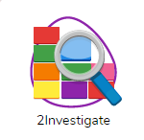
Extended Activity 1: Creating the Database
Slide 5
Over the next two lessons, you must:
Create a database.
Complete a minimum of eight records.
Ensure each record has a minimum of six fields.
Save the database in your work folder and in the shared folder – ensure that the copy in the shared folder has your name in the filename: This is so others can use it to answer questions.
Finished databases could also be shared via a display board or on a 2Blog.
Ask five questions about the database for another pupil to answer.*
Answer questions about someone else’s database.*
*See slide 7
Need more support? Contact us:
Tel: +44(0)208 203 1781 | Email: support@2simple.com | Twitter: @2simplesoftware
Notes:
Use either slide 5 OR slide 6 to outline the activity to be completed over the two lessons.
Some of the lesson time will need to be used for the pupils to research and gather information for their database.

Slide 6
Alternative Activity 1
Slide 6
Open an existing database such as the ‘Countries’ database.
Add eight records of your own to the database.
Save the database in your work folder and in the shared folder – endure that the copy in the shared folder has your name in the filename: This is so others can use it to answer questions.
Finished databases could also be shared via a display board or on a 2Blog.
Ask five questions about the database for another pupil to answer.
Answer questions about someone else’s database.
*See slide 7
Need more support? Contact us:
Tel: +44(0)208 203 1781 | Email: support@2simple.com | Twitter: @2simplesoftware
Notes:
Use either slide 5 OR slide 6 to outline the activity to be completed over the two lessons.
Some of the lesson time will need to be used for the pupils to research and gather information for their database.

Slide 7
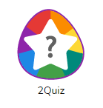
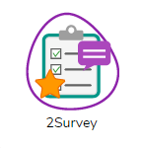
The Questions and Answers
Slide 7
You will be writing the questions using a 2Do\ a printed sheet \ 2Quiz \ 2Survey.
Once you have written the questions, save them in your own work folder \ a shared area \ hand in the 2Do.
Let the teacher know when you have done this.
They will reset the 2Do for someone else in the class \ ask you to give your paper to someone else \ ask you to write a 2Blog post with a link to your quiz\survey.
Try to answer someone else’s questions from your 2Dos \ the shared area \ the blog link.
Check the answers of the person who answered questions about your database.
Need more support? Contact us:
Tel: +44(0)208 203 1781 | Email: support@2simple.com | Twitter: @2simplesoftware
Notes:
Adapt slide 7 to show the method that you wish children to use for writing the questions, handing in and answering others’ questions.

Slide 8
Slide 8
Activity 2: Extension
Evaluate your own database with a focus on the following (from the poster task in lesson 1 extending activity).
Is my spelling correct throughout?
Have I used clear, understandable titles within my database? (Do my field titles explain the data within each of them?)
Have I used drop-down menu options effectively? (Is it possible to enter the same data in different ways?)
Are my image choices relevant? (Do they help others to analyse my database information? For example, can I see how many legs the alien has just from the image?)
Can the questions I have set be answered from the data within my database?
Where necessary, changes can be made to improve their database before being re-saved.
Need more support? Contact us:
Tel: +44(0)208 203 1781 | Email: support@2simple.com | Twitter: @2simplesoftware
Notes:
Use slide 8 to extend some children.

Slide 9
Review Success Criteria
Slide 9
I can create my own database on a chosen topic.
I can add records to the database.
I know what a database field is and can correctly add field information.
I understand how to word questions so that they can be effectively answered using a search of the database.
Need more support? Contact us:
Tel: +44(0)208 203 1781 | Email: support@2simple.com | Twitter: @2simplesoftware
Notes:
Display slide 9. Review the success criteria from slide 3. Children could rate how well they achieved this using a show of hands.

