Slide 1
Anti-Bullying Week

Slide 2
LO: To understand bullying
To demonstrate strategies to deal with bullying.
To demonstrate strategies and skills for supporting others who are being bullied.

Slide 3
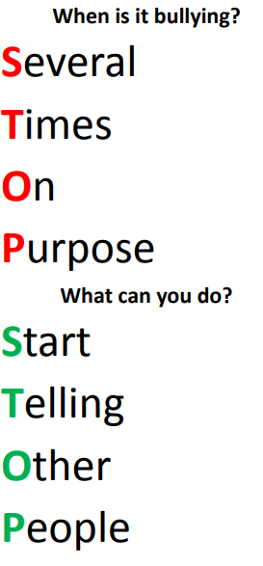
What does bullying mean to you?
"The repetitive, intentional hurting of one person or group by another person or group, where the relationship involves an imbalance of power. It can happen face to face or online."
There are four key elements to this definition:
• Hurtful
• Repetition
• Power imbalance
• Intentional

Slide 4
What are the different types of bullying.
Behaviour can be:
Physical – pushing, poking, kicking, hitting, biting, pinching etc.
Verbal – name calling, sarcasm, spreading rumours, threats, teasing, belittling.
Emotional – isolating others, tormenting, hiding books, threatening gestures, ridicule, humiliation, intimidating, excluding, manipulation and coercion.
Online/cyber – posting on social media, sharing photos, sending nasty text messages, social exclusion.

Slide 5
Discuss/ write your answer
Are any of the types of bullying worse than any of the others?
What different effects might they have on people?
Are there any specific groups of children that might be more at risk of being bullied? Why?
How could we ensure we are doing our best to support these groups?
Notes:
3. Sadly yes- children with SEND, children who are different to the majority e.g. race, ethnicity, religious beliefs etc.

Slide 6
Why do you think somebody might start bullying?
Watch two real life bullying examples video clips:
Jake’s story: Being bullied.
https://www.youtube.com/watch?v=Fi6T4H-SOog
What types of bullying did Jake suffer from? How did it make him feel over time? Why do you think the bullies were bullying Jake? Why do you think Jake didn’t tell anyone? What advice would you give him? If Jake was your friend, how would you help him?
Ariana’s story: Being a bully. https://www.youtube.com/watch?v=_B6ro7M4mZg
Why did Ariana start bullying others? What advice would you give to Ariana? What made Ariana realise that her behaviour was wrong? Who helped her? How did Ariana feel when she started being kind to others? How did her social life change? What could you do to help someone who is being bullied or is being a bully?
Notes:
Have you ever experienced bullying before? If so, would you like to share?

Slide 7
Bullying is not:
• A one off fight between equals
• A falling out between friends
• Hurting someone accidentally
• Borrowing something and forgetting to return.

Slide 8
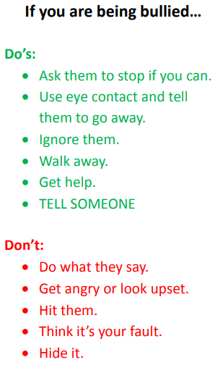
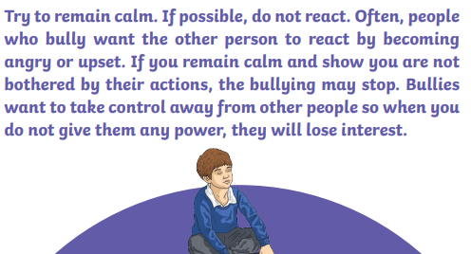
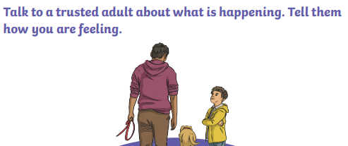
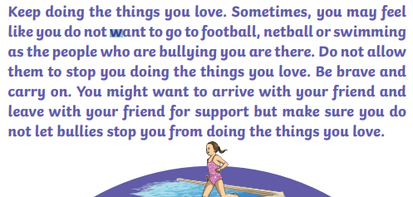
Task
Create your own top tips or strategy cards to put up around the school. Keep the advice clear and concise.

